Slide 1
How to Update Brands and Labels in MIPS
See the last slide for a video tutorial.

Slide 2
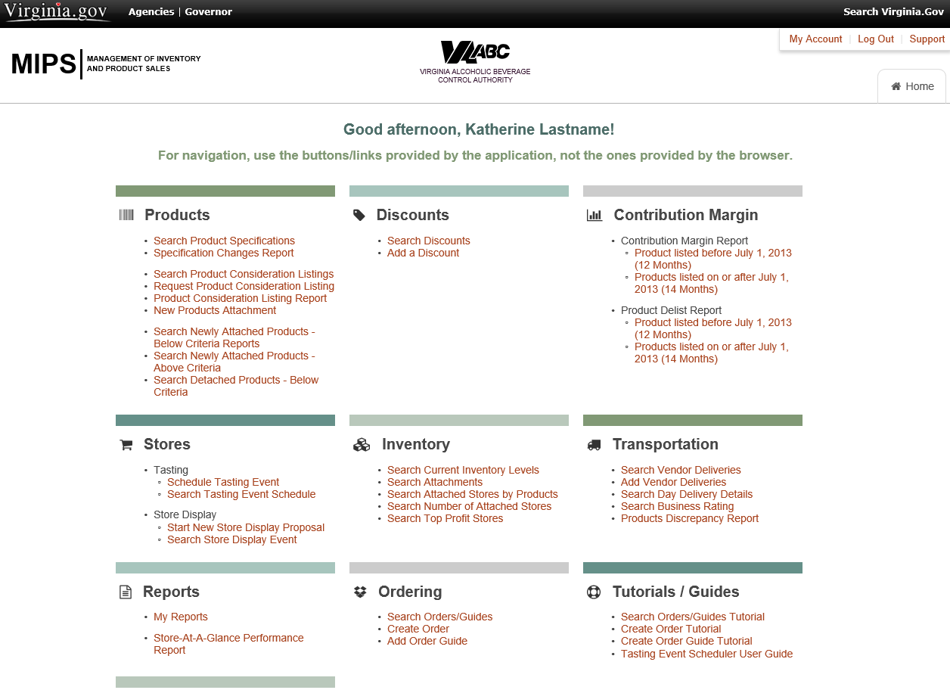
This is Virginia ABC’s MIPS homepage. Here suppliers manage inventory levels, product specifications and much more. This tutorial will show vendors how to update an existing product’s brand and label.

Slide 3
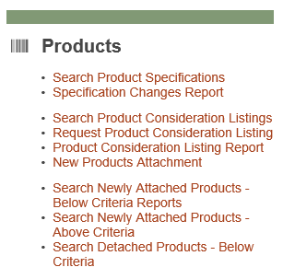
To begin, you will look under the Products category on the MIPS homepage and select “Search Product Specifications.”

Slide 4
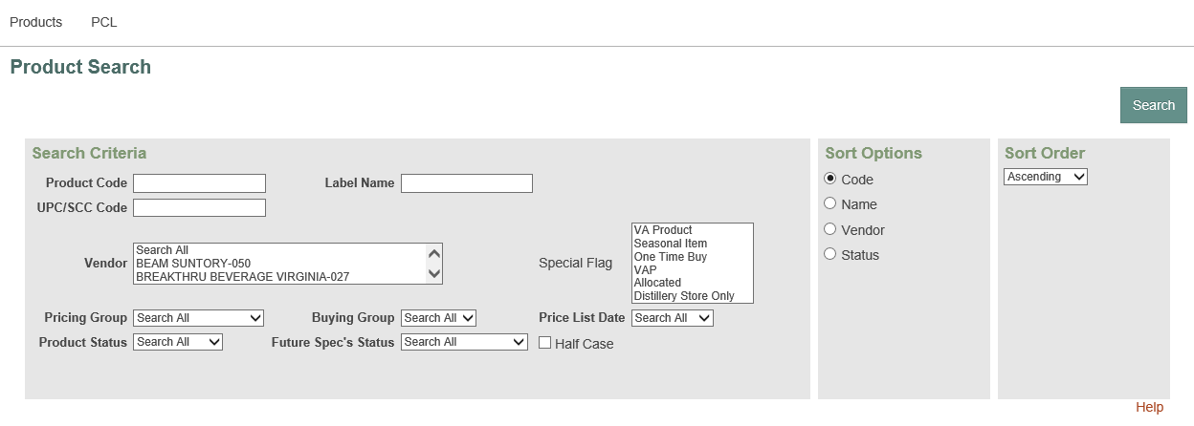
MIPS will take you to this screen where you can search for a specific product to update. You can search by many criteria but the most useful ones are product code, vendor and product status.

Slide 5
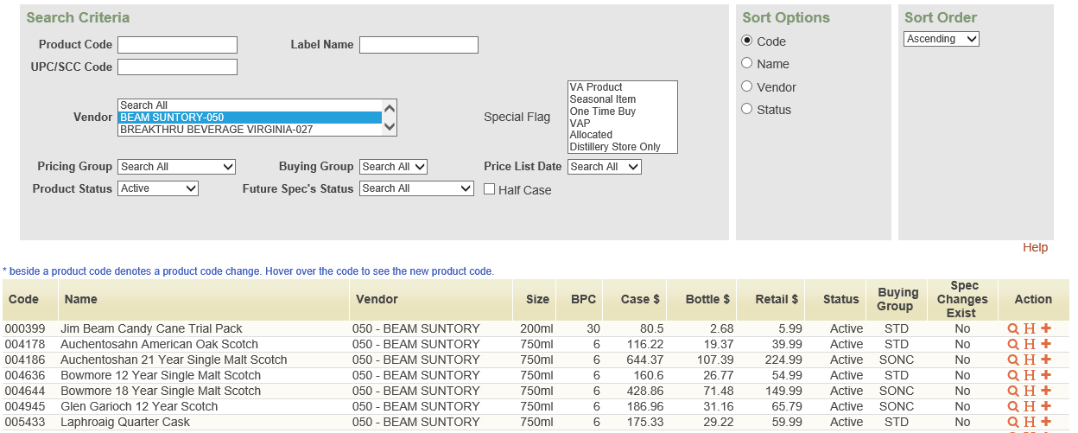
For this example, above is a search for active products by Beam Suntory. To make a change to product specifications, look under the action column on the right side. Each product has the option “view”, “history” or “add spec change”.

Slide 6
Example: You want to change the name of product #010846, “Canadian Club Classic Small Batch Whisky”. You go to the “add spec change” option and update the brand and label.

Slide 7
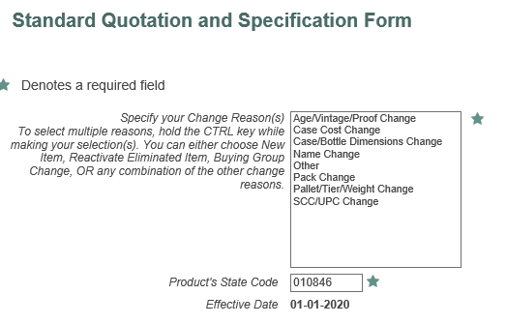
This list should give you the option to update any of these details. Updating this information for accuracy is essential for our processes to run smoothly.
Select “Name Change” from the list and select Next.

Slide 8
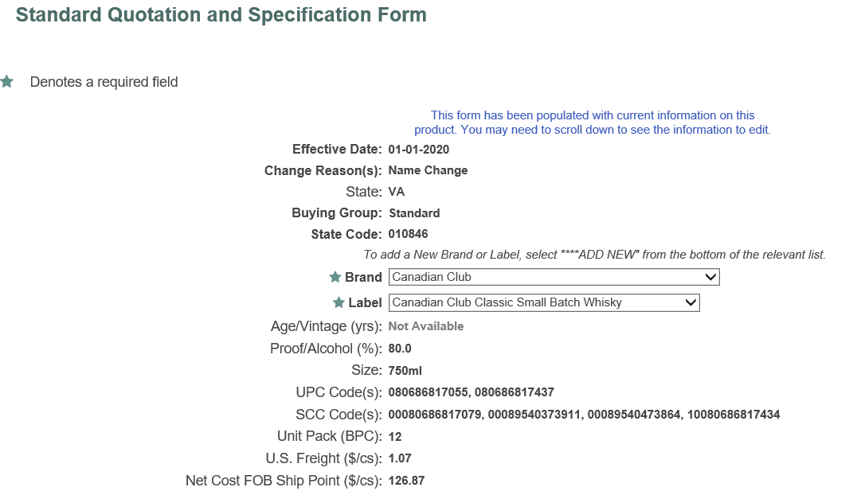
On the next screen you can edit the Brand and Label categories. Select the correct brand from the drop-down list.
Do the same for the Label.
Hit Submit.
Please ensure everything is spelled correctly.

Slide 9
Video Tutorial

Slide 10
Questions?
If you have any troubles or questions with this process, please reach out to the following:
ProductMaster@abc.virginia.gov
Robin Fox, robin.fox@abc.virginia.gov, (804) 213-4524
Todd Neeter, Todd.Neeter@abc.virginia.gov, (804) 213-4528
John Shiffer, John.Shiffer@abc.virginia.gov, (804) 213-4522

