Slide 1
Alcohol, Tobacco and Other Drugs 101
Being Outstanding Leaders Together Against Drugs and Alcohol
Notes:
Educators – the following training for middle school students addresses the following health and physical education SOLs: 6.1(h, i, j, k, l), 6.2(h, i, j, k, l), 6.3(h, i, j, k, l), 7.1(k, l, m), 7.2(k, l, m), 7.3(k, l, m), 8.1(i), 8.2(h), and 8.1(i, j), 8.2(i, j) and 8.3 (i, j)
This training can be used in conjunction with the Virginia ABC Learn Alcohol Basics for Middle School Students guide as well as the Substance Use Jeopardy game.

Slide 2



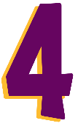

We will learn about…
The definition of a drug
Examples of alcohol, tobacco and nicotine products and other drugs
How drugs impact the body and brain
Short- and long-term effects of drugs
Substance use influences and how to refuse peer pressure
Notes:
Today we will learn about:
(Reveal 1) The definition of a drug
(Reveal 2) Examples of alcohol, tobacco and nicotine products and other drugs
(Reveal 3) How drugs impact the body and brain
(Reveal 4) Short- and long-term effects of drugs
(Reveal 5) Substance use influences and how to refuse peer pressure

Slide 3
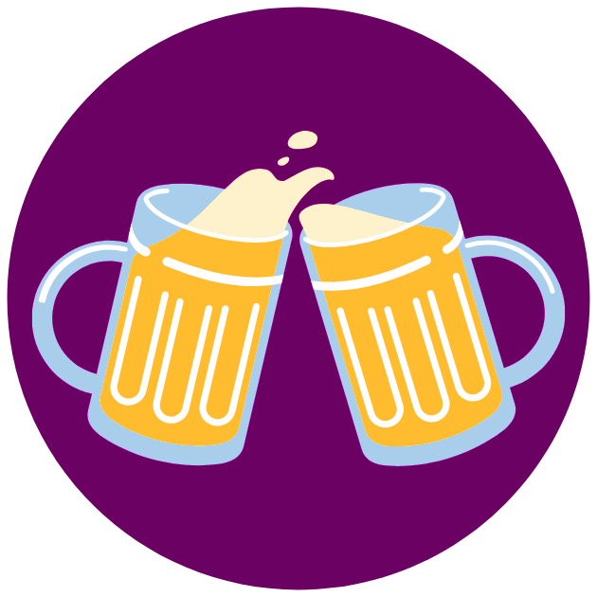
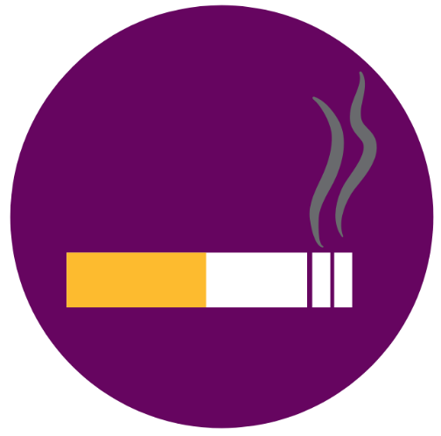

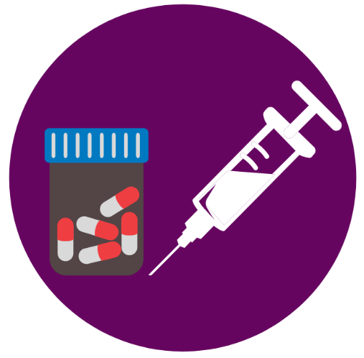
What is a drug?
A drug is any chemical that affects the human body or mind when it is swallowed, breathed in or consumed in another way.
Notes:
Ask the class: “What is a drug?” and have them share what they know about what classifies something as a drug.
(Reveal 1) Share: “ a drug is any chemical that affects the human body or mind when it is swallowed, breathed in or consumed in another way.”
Reveal each image on the slide and say, “alcohol, tobacco and other drugs such as marijuana and other illegal substances are all classified as a drug.”

Slide 4
ALCOHOL
Notes:
To start, we are going to first talk about alcohol. What it is, types of alcohol, how alcohol affects the brain and body, the short and long-term effects of alcohol consumption and discuss Virginia law related to alcohol.

Slide 5

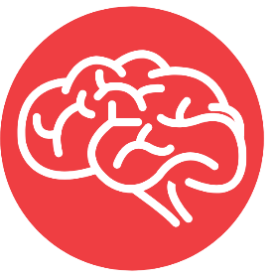
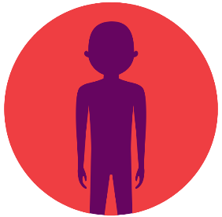
What is alcohol?
Alcohol is created naturally when sugars in grains, vegetables and fruits are fermented.
Alcohol is defined as a drug because it reduces your ability to think rationally and impairs your judgment.
It is a depressant, which means that it slows down your body functions.
Notes:
(Reveal 1) Alcohol is a drug that is created naturally when sugars in grains, vegetables and fruits are fermented. The different types of fermented products lend to the alcohol’s flavor. The process of fermentation breaks down sugars in grains, vegetables and fruits and converts them to ethyl alcohol.
(Reveal 2) Alcohol is defined as a drug because it reduces your ability to think rationally and impairs your judgment.
(Reveal 3) All drugs are classified into different categories – alcohol is classified as a depressant, which means that it slows down your body functions. We will talk more about drug classifications throughout the PowerPoint.

Slide 6
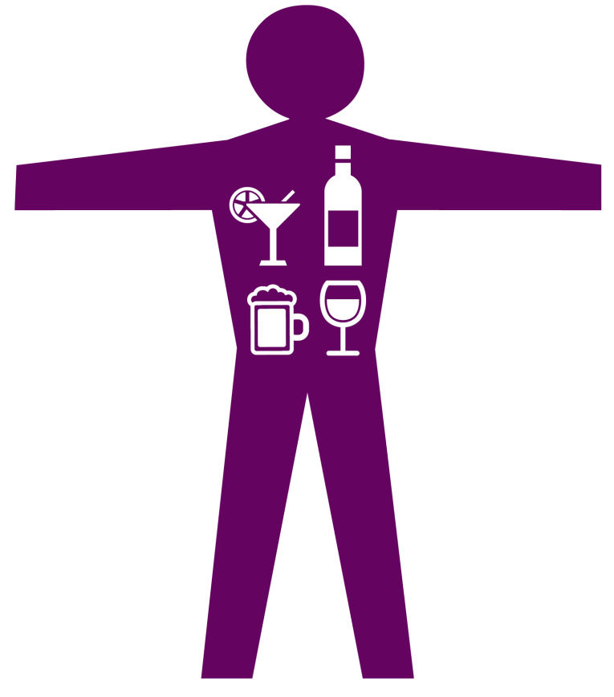
Blood Alcohol Concentration
Blood alcohol concentration (BAC) is the amount
of alcohol that is present in the bloodstream.
BAC can be estimated based on the number of drinks a person consumes, weight and biological sex.
Notes:
Before we begin discussing the various types of alcohol I want to define a few terms that we will use throughout the training.
The first term is blood alcohol concentration or BAC. BAC is the amount of alcohol that is present in the bloodstream. For example, having a BAC of 0.10 percent means there is about one drop of alcohol for every 1,000 drops of blood in the body. At certain BAC levels, alcohol has been shown to alter a person’s visual functions and perceptions, affecting his or her ability to react, concentrate or pay attention, process information and operate a vehicle.

Slide 7


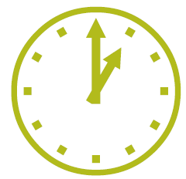

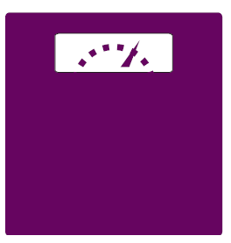
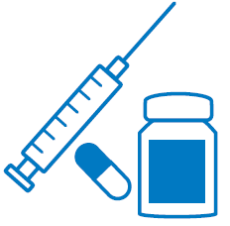
What affects your BAC level?
Strength of Drink
Food
Rate of Consumption
Biological Sex
Body Size/Weight
Drug Use
Notes:
Many factors can affect an individual’s BAC.
How much alcohol is in the drink or the strength of the drink is a factor. We will discuss this more in the next slide.
The rate of consumption, so how quickly someone is consuming alcohol.
An individual’s body size or weight contributes to BAC levels. An individual who weighs 200 pounds will process alcohol differently than someone who weighs 150 pounds.
How much food an individual has consumed is an important factor. It’s very important to drink alcohol on a full stomach. Food, especially foods high in protein, slows the absorption of alcohol into the blood stream.
An individual’s biological sex impacts their BAC as well. On average, females tend to be smaller than males and tend to have more body fat and carry less water than males. Body fat retains alcohol and water helps disperse alcohol.
Other drug use can also impact an individual’s BAC. Many medications when combined with alcohol can intensify the effects and pose a danger to your health.
Suggestions like taking a cold shower or having coffee will not lower your BAC level. Only time will lower your BAC.

Slide 8
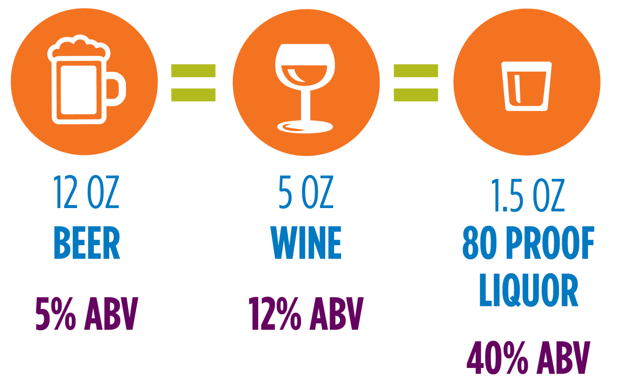
What are standard size drinks?
Standard size drinks contain approximately the same amount of alcohol and help estimate blood alcohol concentration (BAC)
The liver typically processes one standard size drink per hour
Alcohol is not always served in the same size constraints
Notes:
On the last slide we referenced that the strength of a drink can impact an individual’s BAC. A standard size drink is a term for equating various types of alcoholic beverages to one another.
Standard size drinks contain approximately the same amount of alcohol and help estimate blood alcohol concentration (BAC). This is because the liver metabolizes or processes one standard size drink per hour.
Standard size drinks are defined as 12 ounces of beer at 5% alcohol by volume (ABV), 5 ounces of wine at 12% ABV and 1.5 ounces of liquor at 80 proof or 40% ABV.
However, the percentage of alcohol found in different kinds of beer, wine or mixed beverages are not always equal to that of a standard size drink. For example, one mixed drink at a restaurant could equal three standard size drinks due to the amount of alcohol it contains.
Individuals may not be aware of what a standard size drink is or how to calculate the number of standard size drinks they’ve had in one sitting. This disconnect could lead to inaccurate tracking of alcohol consumption and binge drinking, which we will now explore further.

Slide 9
What is binge drinking?
Binge drinking is the excessive consumption of alcohol that brings BAC levels to at least 0.08% in about 2 hours
Heavy alcohol use is binge drinking on five or more days in the past month
Most people younger than age 21 who drink alcohol report binge drinking
3.7% of 8th graders, 8.7% of 10th graders and 14.4% of 12th graders reported drinking 5+ drinks in a row in the last two weeks
Notes:
Binge drinking is the excessive consumption of alcohol that brings blood alcohol concentration (BAC) levels to at least 0.08% in about two hours. It’s also defined as consuming five or more alcoholic drinks for men or four or more alcoholic drinks for women in one sitting. This is referring to standard size drinks, as discussed on the previous slide. Heavy alcohol use is binge drinking on five or more days in the past month.
We see binge drinking occur the most among adults 18-34 years old and it’s twice as common among men than women.
In fact, most drinkers under the age of 21 report binge drinking and often consume excessively harmful amounts when binge drinking does occur.
According to the 2019 Monitoring the Future Survey, 3.7% of 8th graders, 8.7% of 10th graders and 14.4% of 12th graders reported drinking 5+ drinks in a row in the last two weeks.

Slide 10
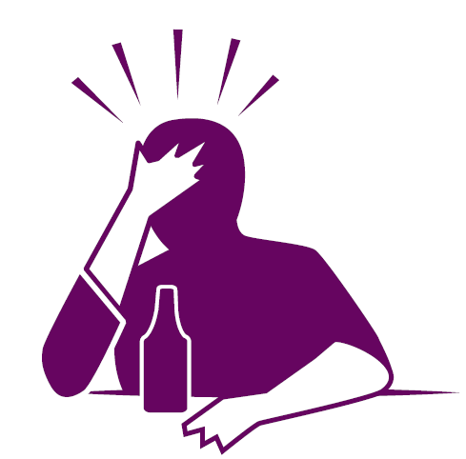
What are the health risks of binge drinking?
Unintentional injuries
Violence
Sexually transmitted diseases and unintended pregnancy
Chronic diseases and cancers
Police involvement
Memory and learning problems
Alcohol dependence
Notes:
Binge drinking is associated with many health problems, including:
Unintentional injuries such as car crashes, falls, burns, and alcohol poisoning.
Violence including homicide, suicide, intimate partner violence, and sexual assault.
Sexually transmitted diseases, unintended pregnancy and poor pregnancy outcomes, including miscarriage and stillbirth.
Chronic diseases such as high blood pressure, stroke, heart disease, and liver disease. For example, two or more standard drinks per day increases the risk for high blood pressure. Cancer of the mouth, throat, esophagus, liver, breast, and colon. Alcohol is a carcinogen and the risk of cancer increases with the number of drinks consumed.
Vandalism, property damage, and police involvement.
Memory and learning problems.
Alcohol dependence.
Next we will review different common types of alcohol.

Slide 11

FLASH FACTS
People ages 12 through 20 drink 11% of all alcohol consumed in the United States.
1.3 million youth reported binge drinking on 5 or more days over the past month.
Notes:
According to the Centers for Disease Control and Prevention, people ages 12 through 20 drink 11% of all alcohol consumed in the United States. While youth drink less frequently than adults, when youth do drink they drink more. Youth often participate in binge drinking, which is defined as consuming multiple drinks in a specific amount of time. For example, binge drinking for males is consuming five or more alcoholic drinks in a two hour period and for females is four or more alcoholic drinks in a two hour period
From the Substance Abuse and Mental Health Services Administration, 1.3 million youth reported binge drinking on five or more days over the past month. In a few more slides we will review short and long-term effects of alcohol consumption to better understand how alcohol affects decision making and other areas of the brain and body.

Slide 12

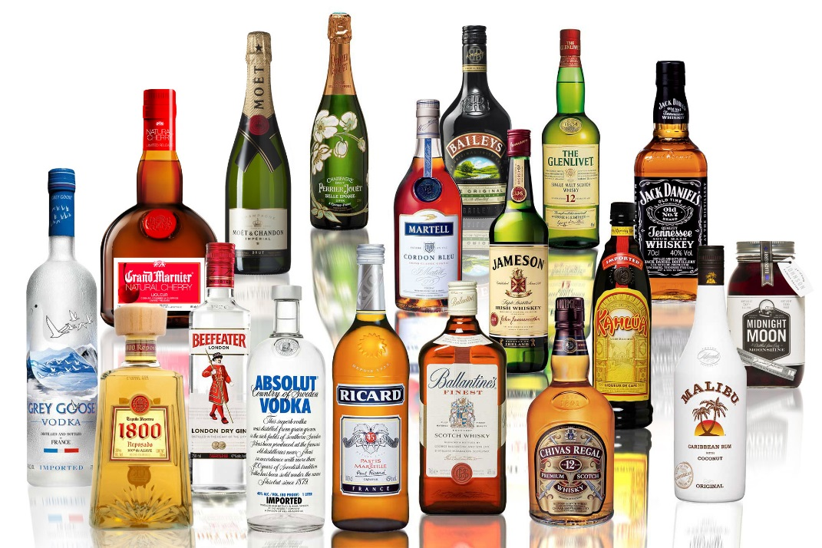
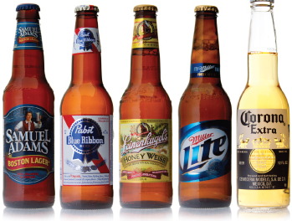

Types of Alcohol
Beer
Wine
Liquor
Notes:
There are many different types of alcohol. Beer, wine and liquor are the most common forms of alcohol.
(Reveal 1) Beer is brewed from grains from malted barley, wheat, maize and even rice. A standard-size drink of beer is 12 ounces.
(Reveal 2) Wine is formed from fermented fruit, most commonly grapes. A standard-size drink of wine is 5 ounces.
(Reveal 3) Liquor is formed through a distillation process which purifies the liquid and removes water resulting in a higher content of alcohol. A standard-size drink of liquor is 1.5 ounce.
Not all beers, wines or liquors have the same amount of alcohol in them.
To purchase alcohol, you must be 21 years of age or older. Beer or wine can be purchased in most grocery stores, supermarkets and gas stations while liquor can only be purchased in a Virginia ABC store.

Slide 13

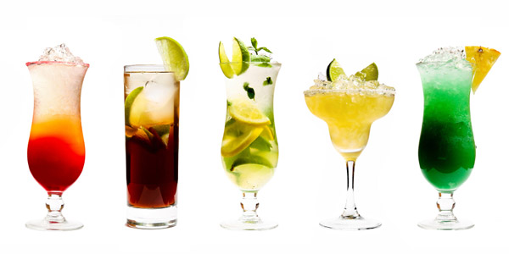
Types of Alcohol
Mixed Drinks
Hard Cider
Notes:
(Reveal 1) Mixed drinks consist of liquor combined with fruit juice, soda and/or other ingredients. Mixed drinks are often served at bars and restaurants. There is not a set amount of alcohol within a mixed drink. For example, two mixed drinks could both have eight ounces of liquid, but one could have significantly more alcohol than the other. This can be dangerous for any person because while someone may be consuming one drink, they could be consuming two to three standard-sized alcoholic beverages.
(Reveal 2) Cider is an alcoholic beverage made from the fermented juice of apples. It is important to know the difference in non-alcoholic and alcoholic ciders. Both can be purchased at grocery stores and can look similar in their packaging.

Slide 14
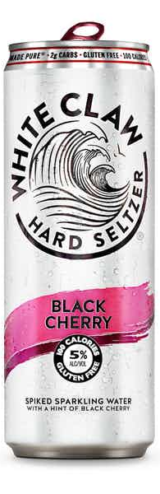
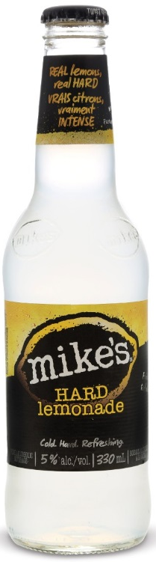
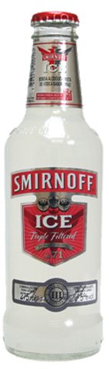
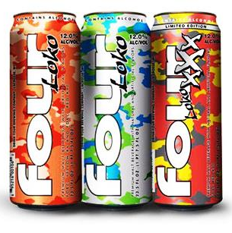
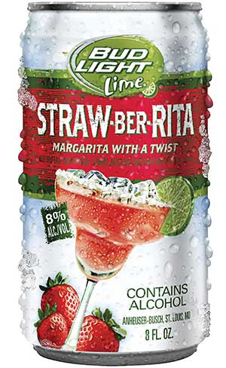
Types of Alcohol
Malt Beverages
Alcoholic Energy Drinks
Notes:
(Reveal 1) Malt beverages is another category of alcohol. They can appear to be harmless and refreshing due to their light color and branding but can be just as dangerous as a mixed drink, beer or wine. Malt beverages include spiked seltzer water, or seltzer water with alcohol added.
(Reveal 2) Alcoholic energy drinks are extremely dangerous. The mixture of alcohol and caffeine can cause side effects, such as heart palpitations or racing, problems sleeping, feeling tense or agitated, anxiety and panic attacks.
You probably have seen a few of these beverages that are advertised to look and sound appeal to youth; they have bright colors and flavorings that resemble different flavored candies. Both of these categories of drinks look very similar to regular seltzer waters and energy drinks, so it is important to pay attention and make sure you are drinking non-alcoholic beverages. The impact of consuming alcoholic beverages under the age of 21 can be severe to both your body and your brain.

Slide 15
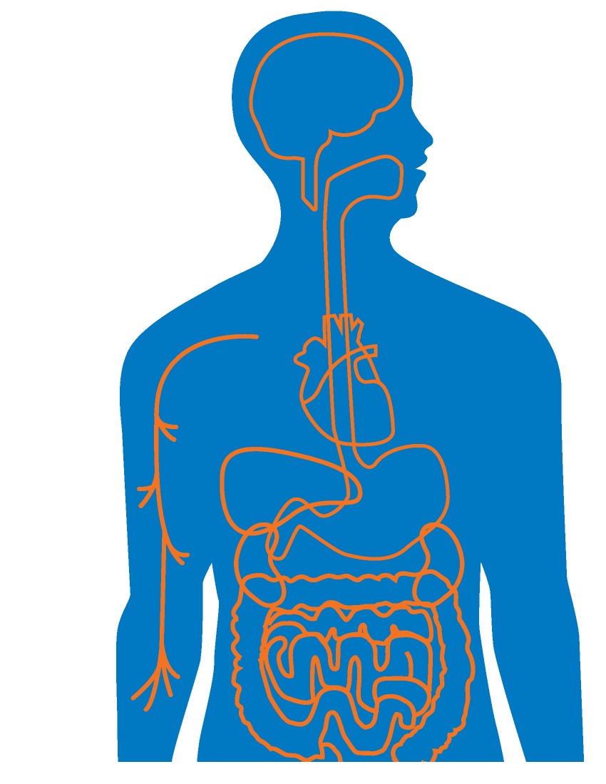
What does alcohol do to your body and brain?
The alcohol in your bloodstream travels to other organs in your body, including the brain.
1
Alcohol is swallowed.
2
Alcohol enters your stomach through your esophagus.
4
Your small intestine and stomach lining absorb alcohol into the bloodstream.
3
The liver metabolizes alcohol, it’s processed by the kidneys and then is eliminated from your body.
5
Notes:
(Reveal1) When alcohol is consumed it enters through the mouth and then (Reveal 2) enters your stomach through the esophagus. (Reveal 3) Your small intestine and stomach lining then absorb alcohol into the bloodstream. When alcohol enters the bloodstream, your entire body then becomes impaired increasing risks of accidents, fights and injuries. (Reveal 4) Next, alcohol then travels through your bloodstream to other organs in your body including your brain and liver. The brain is severely impacted by alcohol because it alters the ability to make decisions, can give a false sense of self-confidence and impairs your learning and memory. Alcohol also delays reaction time and motor skills such as coordination and balance. You can get seriously hurt if you can’t control your body. (Reveal 5) When alcohol reaches your liver, your liver then metabolizes it, or breaks it down, then is processed by the kidneys and is eliminated from your body through urine.
The way your body reacts to alcohol depends on your biological sex, weight and rate of alcohol consumption. Your brain and body are still growing and won’t stop until you have reached your mid-twenties. For healthy development, our brain needs an alcohol and drug-free body.

Slide 16

Alcohol’s effect on the brain
Watch Here
Notes:
Play video

Slide 17
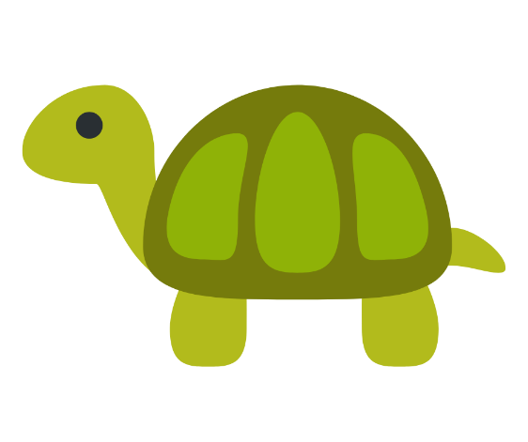

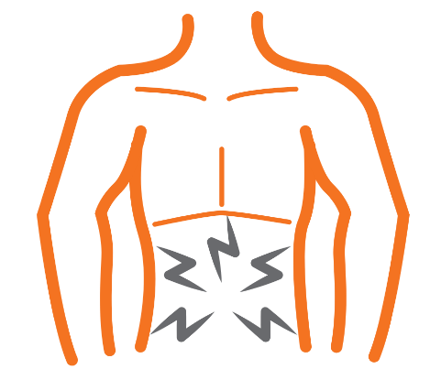
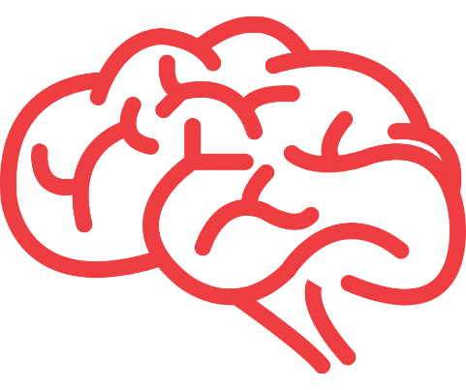

Short-Term Effects of Alcohol Use
Slower reaction times and reflexes
Heavy
sweating and dehydration
Nausea and vomiting
Lowered reasoning ability
Blurry vision
Notes:
Once in the bloodstream., alcohol begins to physically affect your body and actions. Short-term effects of alcohol use include:
(Reveal 1)Slower reaction times and reflexes – Alcohol is a depressant which means it slows everything down in your body including your brain sending messages to the rest of your body to act. This can lead to dangerous situations and can risk the safety of yourself and others.
(Reveal 2) Heavy sweating and dehydration – When alcohol is consumed, heart rate increases and blood vessels in skin widen or dilate. Dilated blood vessels cause the skin to feel warm and triggers the release of sweat.
(Reveal 3) Blurry vision – Blurry and double vision can be a result of excessive alcohol consumption due to weakened eye muscle coordination.
(Reveal 4) Nausea and vomiting – Alcohol is a toxin, so it easily can upset your stomach causing nausea and vomiting. Additionally, excessive alcohol consumption can lead to the body rejecting alcohol through vomiting.
(Reveal 5) Lowered reasoning ability – Alcohol impacts how your brain sends messages to other parts of the brain and body. Under the influence of alcohol you are unable to make good decisions and your inhibitions are lowered meaning you may participate in negative behaviors like risk taking.

Slide 18
Alcohol Poisoning
Alcohol poisoning occurs when an excessive amount of alcohol is consumed.
Signs of alcohol poisoning include:
Confusion
Slow or no reflexes or response
Difficulty remaining conscious
Vomiting
Trouble breathing
Clammy or pale skin
Bluish lips
Seizures
Notes:
Binge drinking and participating in drinking games can increase the likelihood of a drinker to have alcohol poisoning. Alcohol poisoning occurs when an excessive amount of alcohol is consumed, resulting in a high BAC. A large volume of alcohol in the bloodstream causes the body and its major functioning organs like the brain to consequently shut down.
Signs of alcohol poisoning include:
Confusion
Slow or no reflexes or response
Difficulty or inability to remain conscious
Vomiting
Trouble breathing
Clammy or pale skin
Bluish lips
Seizures
If someone is showing any of the signs listed or if you believe someone has alcohol poisoning, call 911 immediately. Alcohol poisoning is dangerous and can lead to death.

Slide 19

SPARK A DISCUSSION
What do you think are some of the
long-term effects of alcohol use?
Notes:
Ask students the following prompt: ‘What do you think are some of the long-term effects of alcohol use?”
Allow them to share answers before moving onto the next slide.

Slide 20

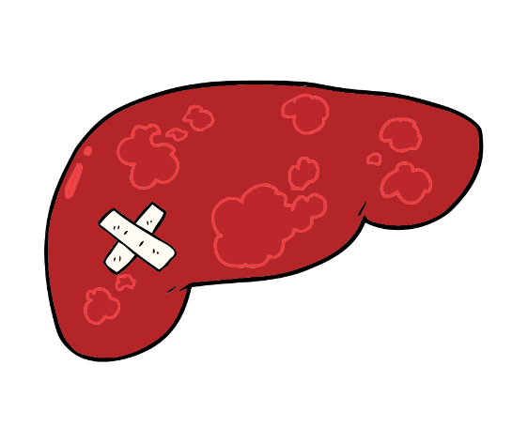



Long-Term Effects of Alcohol Use
Cirrhosis or permanent
liver damage
Nervous system damage
Muscles shrinking
Hallucinations
Death
Notes:
There are many lasting effects of heavy and long-term alcohol consumption.
(Reveal 1) Cirrhosis or permanent liver damage – Repeated and excessive alcohol use leads to cirrhosis of the liver. Over time, healthy liver tissue begins to scar causing the liver not to work as well as it did before. Because of this, the body can’t filter toxins out of blood as it should.
(Reveal 2) Nervous system damage – Chronic alcohol use can lead to damage of your nervous system that can cause permanent imbalance that leads to poor coordination and difficulties walking.
(Reveal 3) Muscles shrinking – Alcohol decreases the amount of blood flow to muscles like the heart. Weakening of heart muscles can lead to disorders such as cardiomyopathy where the heart beats slowly or sluggishly. Alcohol also delays the repair of lost or damaged muscle.
(Reveal 4)Hallucinations – or seeing, hearing, smelling, tasting or feeling something that doesn’t exist outside of your mind can be a result of alcohol abuse and are categorized as an alcohol-induced psychotic disorder.
(Reveal 5) Death – According to the World Health Organization, each year, alcohol is the cause of 5.3% of all human deaths. Roughly one in every 20 deaths throughout the world is a result of alcohol-related disease, injury, accident, murder or suicide. The major causes of alcohol-related death are alcohol poisoning, cancer, car accidents, heart failure, liver damage and violence.

Slide 21
FLASH FACTS
Teens who begin drinking before the age of 15 are 5 times more likely to develop alcohol dependence or abuse later in life than those who begin drinking at or after the age of 21.
Notes:
According to the Centers for Disease Control and Prevention, teens who begin drinking before the age of 15 are five times more likely to develop alcohol dependence or abuse later in life than those who begin drinking at or after the age of 21.

Slide 22
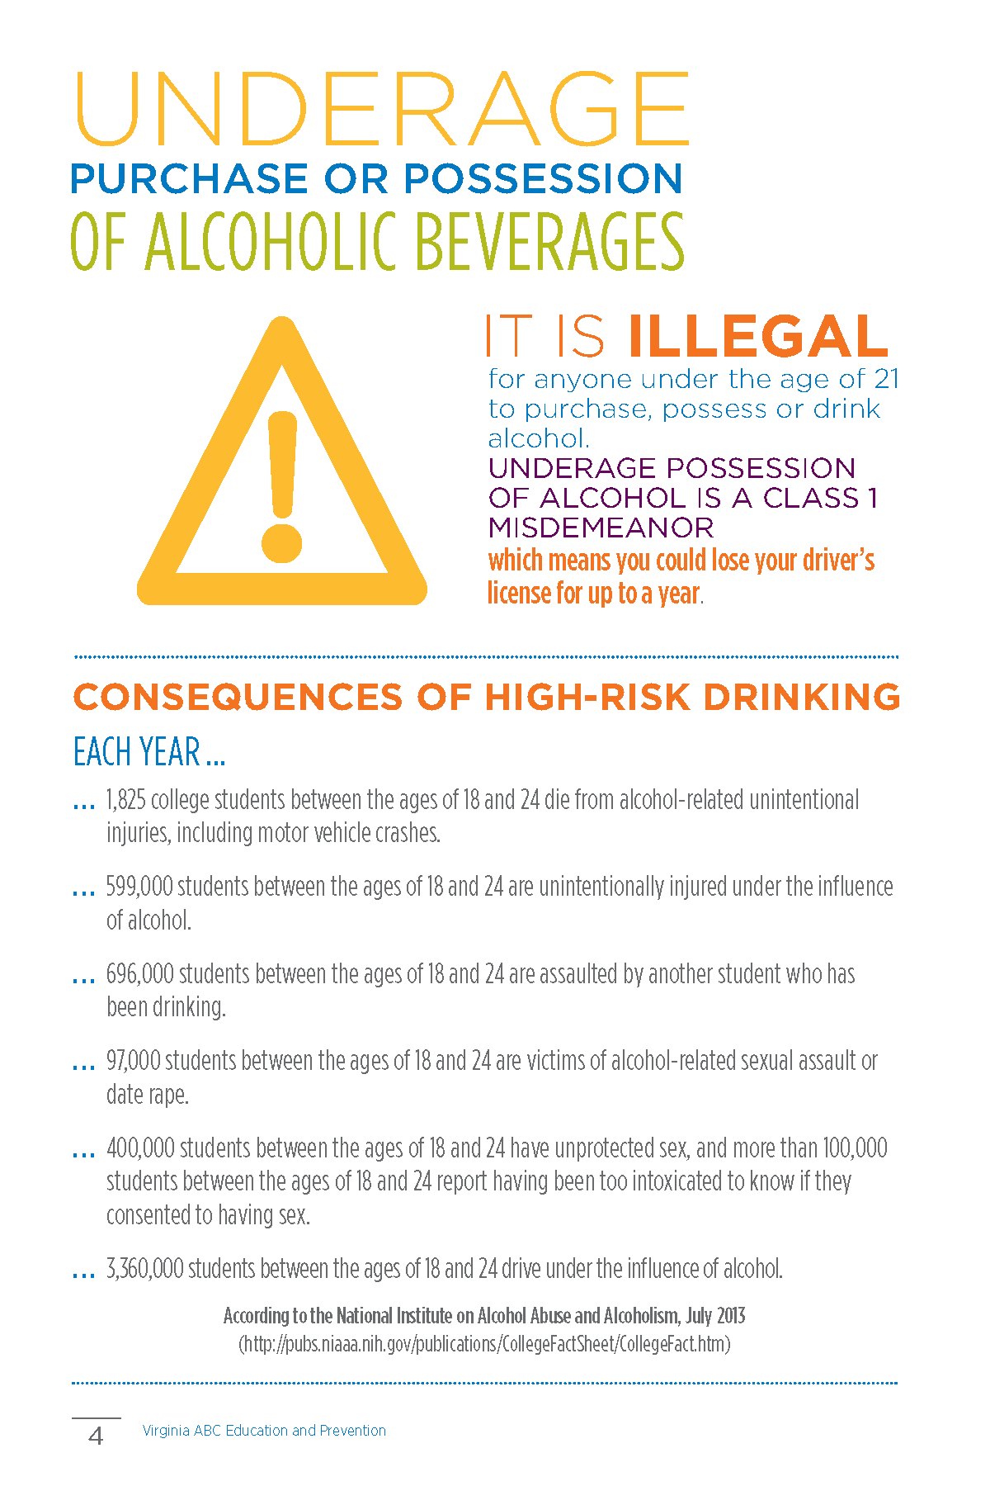
Virginia Law
It is illegal for anyone under the age of 21 to
purchase, possess or drink alcohol.
Purchasing or providing alcohol to anyone under the age of 21 is illegal and also known as social providing.
Notes:
It is illegal for anyone under the age of 21 to purchase, possess or drink alcohol. Additionally, purchasing or providing alcohol to anyone under the age of 21 is illegal and also known as social providing. Underage possession of alcohol is a Class 1 Misdemeanor and could result in a fine up to $2,500, 12 months in jail and/or losing your driver’s license for up to a year.

Slide 23
TOBACCO
Notes:
Next, we are going to discuss tobacco - what it is, types of tobacco and nicotine products, vaping , the short and long-term effects of tobacco and nicotine and Virginia law.

Slide 24
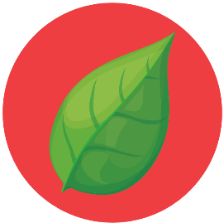
What is tobacco?
Tobacco is a plant used to make smoke tobacco and smokeless tobacco.
Tobacco contains nicotine, both a sedative and a stimulant drug.
Nicotine contains the addictive properties leading to individual's dependency on tobacco and nicotine products.
Notes:
(Reveal 1) Tobacco is a plant used to make material for smoking, chewing and other uses through a variety of products.
(Reveal 2) Tobacco contains nicotine, which is both a sedative drug, meaning that it has calming properties, and a stimulant drug, meaning that it promotes activity.
(Reveal 3) Nicotine contains the addictive properties leading to an individual’s dependency on tobacco and nicotine products. According to the United States Surgeon General, it is just as addictive as cocaine or heroin.

Slide 25


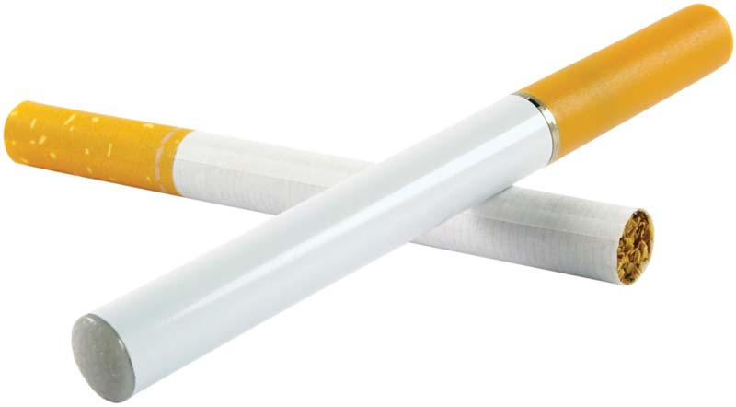
Types of Tobacco Products
Cigarette
Cigar
Pipe
Notes:
(Reveal 1) A cigarette is tobacco that is rolled or wrapped in paper for smoking. According to the National Institute on Drug Abuse, cigarette smoking is the most popular method of using tobacco. With each smoke inhalation, a smoker takes in one to two milligrams of nicotine per cigarette. If someone smokes about one pack a day, or 20 cigarettes daily, that is about 200 “hits” daily of nicotine to the brain.
(Reveal 2) A cigar differs from a cigarette in that the tobacco is rolled in a tobacco leaf or another substance that contains tobacco. Unlike cigarettes, cigars can be purchased individually. According to the Centers for Disease Control and Prevention, some cigar brands infuse flavors into their products. This and the fact that they are sold individually raises concern that products are appealing to youth.
(Reveal 3) In a pipe, tobacco sits in the bowl at the end and a stem connects the bowl to the mouthpiece. Like smoking a cigar, smoking with a pipe the smoke is not inhaled. With cigarette and cigar smoking, nicotine is absorbed through mucous membranes in the mouth and reaches peak blood and brain levels more slowly than with a cigarette.

Slide 26
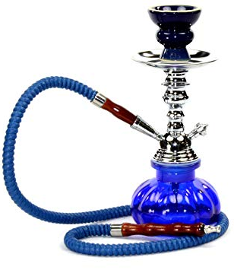
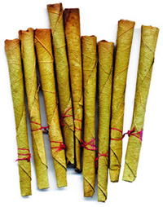

Types of Tobacco Products
Bidi
Hookah
Smokeless Tobacco
Notes:
(Reveal 1) A bidi (bee-dee) is a small, thin, hand-rolled cigarette imported from Southeast Asian countries. Like a cigar, bidis are tobacco wrapped in a leaf, but not specifically a tobacco leaf. According to the CDC, bidis contain three to five times more of the amount of nicotine as a regular cigarette and increases the risk for cancers. Bidis also have higher concentrations of nicotine, tar and carbon monoxide than a traditional cigarette.
(Reveal 2) According to the CDC, in 2018 one of every 100 middle school students reported using hookah in the past 30 days. A hookah is a pipe with a long, flexible tube for drawing smoke from lit, flavored tobacco through water contained in a small bowl. While users may believe that hookah is less dangerous than cigarettes, one session of hookah smoking exposed users to greater volumes and higher levels of tobacco toxins than one cigarette.
(Reveal 3) Smokeless tobacco includes products like chewing tobacco and snuff that are placed in the mouth between the teeth and gums. In 2018, two out of every 100 middle schoolers reported using smokeless tobacco in the past 30 days. This is almost one percent decrease since 2011. The use of smokeless tobacco can lead to white patches inside the mouth that can lead to cancer as well as gum disease, tooth decay and tooth loss.

Slide 27
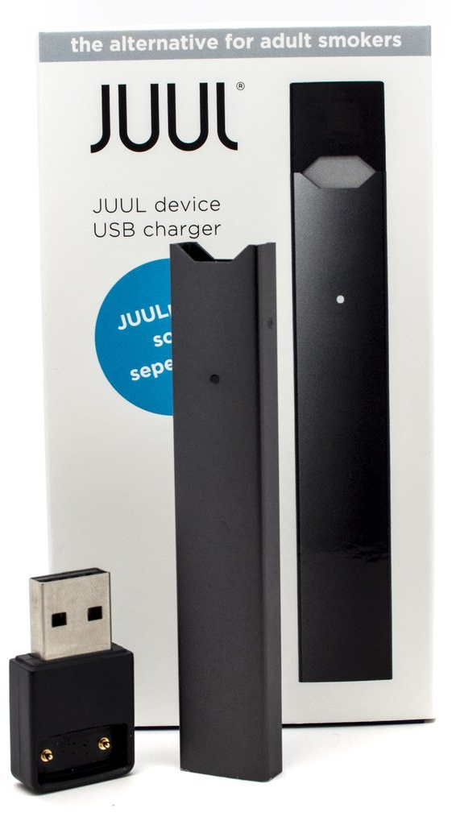
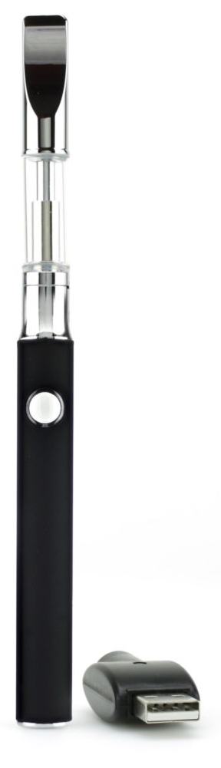
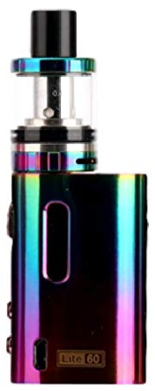
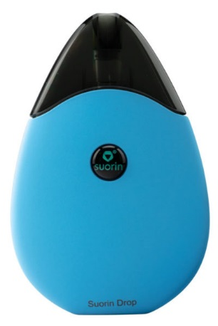
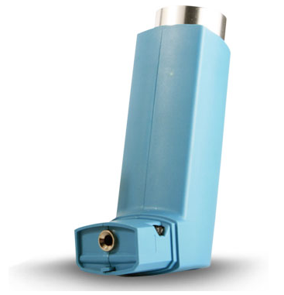
Types of Nicotine Products
Electronic Cigarettes/E-Cigarettes/Vapes
Notes:
An electronic cigarette, referred to as an e-cigarette or vape, is a battery-powered vaporizer that simulates smoking. When smoking an e-cigarette, the user inhales a vapor that typically contains nicotine, flavorings and other chemicals to produce the vapor. E-cigarettes come in multiple forms and can resemble everyday objectives like pens, highlighters, USB sticks and even inhalers. While e-cigarettes generally contain fewer toxins than regular cigarettes, the vapor is not harmless and can contain harmful substances including nicotine, heavy metals, volatile organic compounds and cancer-causing toxins. While adults do use e-cigarettes, they are most commonly used among youth. The availability of flavored types of nicotine products and the ability to use a product that looks like an everyday object makes e-cigarettes appealing to youth, even though they are not intended for youth.

Slide 28
Vaping versus Smoking
Watch Here
Notes:
Play video

Slide 29
FLASH FACTS
In the past 30 days:
5% of middle schoolers have used e-cigarettes
3.6 million middle and high school students
have used e-cigarettes in the past 30 days
Notes:
According to the CDC, five percent of middle schoolers have used e-cigarettes in the past 30 days. In 2018, 3.6 million middle and high schoolers reported using e-cigarettes in the past 30 days.

Slide 30
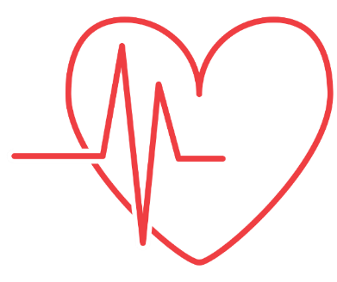

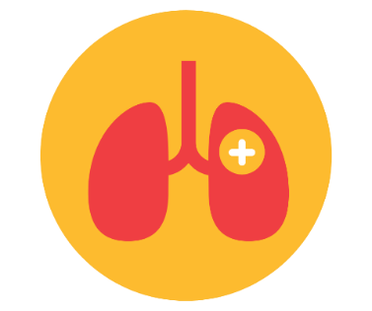

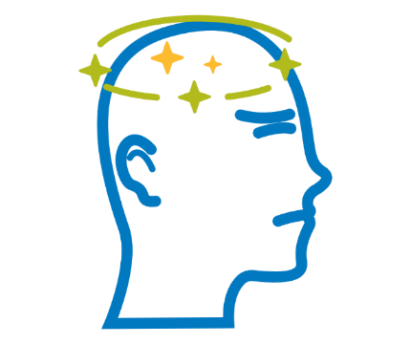

Short-term Effects of Nicotine Use
Increased heart rate and blood pressure
Raised alertness
Increased breathing activity
Relaxed feeling and reduction of anxiety
Dizziness and lightheadedness
Irregular and disturbed sleep
Notes:
Regardless of the method of exposure to nicotine, there are many effects.
(Reveal 1) When the body is exposed nicotine, the individual experiences a boost or a kick as a result of adrenaline release. This adrenaline release stimulates the rest of the body resulting in an increase in heart rate, blood pressure and breathing activity.
(Reveal 2) Dizziness and lightheadedness can occur when smoke fills the lungs preventing oxygen to flow through the bloodstream. While the dizziness may not last for a long amount of time, it can continue to happen with long-term use.
(Reveal 3) Nicotine has varying psychological effects. When nicotine enters the bloodstream it affects the messages that the brain sends to the rest of the body. It can provide an almost calming effect for some users while for others it can increase their alertness. .
(Reveal 4) Nicotine disrupts sleep and smoking can raise the risk of developing sleep conditions such as sleep apnea. However, because it is a stimulant, the raised alertness nicotine can provide masks exhaustion.

Slide 31
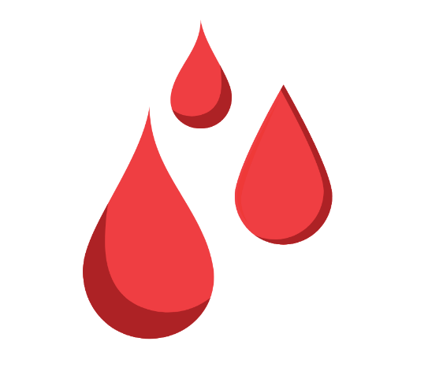
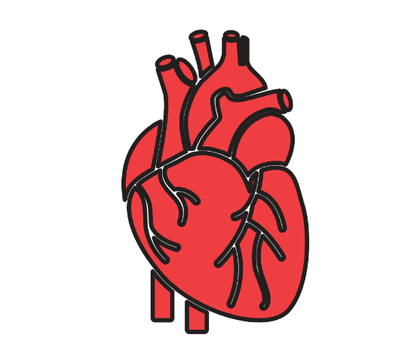
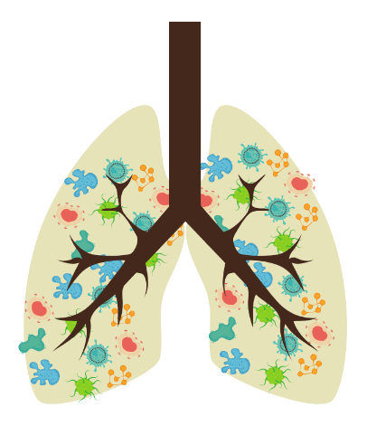
Long-term Effects of Nicotine Use
Increased clotting tendency
Indigestion, peptic ulcers, diarrhea, heartburn
Increased risk of stroke and possible blood restriction
Problems with the heart and arteries
Cancer
Notes:
Like alcohol, there are long-term health effects of prolonged nicotine use.
(Reveal 1) Increased clotting tendency, leading to a risk of life-threatening blood clots.
(Reveal 2) Using nicotine products can increase a user’s risk for many types of cancer including: lung, larynx, mouth, throat, bladder, stomach, esophageal, kidney, liver, pancreas and colon.
(Reveal 3) Long-term smoking can lead to cardiovascular disease, or problems with the heart, including the following conditions, coronary artery disease and enlargement of the aorta. Coronary artery disease is when plaque builds up on artery walls narrowing the artery and limiting blood and oxygen flow to the brain that can lead to a heart attack. The aorta is the main artery of the body; an enlargement can lead to the artery rupturing causing dangerous and life-threatening bleeding.
(Reveal 4) Smoking increases the risk of indigestion, peptic ulcers, diarrhea and heartburn.
(Reveal 5) The risk of stroke and possible blood restriction is increased in users of nicotine products compared to those who do not use.

Slide 32
SPARK A DISCUSSION
What do you think are some reasons that teens might start using nicotine products?
Notes:
Ask students the following prompt: ‘What do you think are some reasons that teens might start using nicotine products?”
Allow them to share answers before moving onto the next slide.

Slide 33
Virginia Law
In the state of Virginia, and the United States, to purchase and use tobacco products you must be 21 years of age.
Notes:
In the state of Virginia, and the United States, to purchase and use tobacco products you must be 21 years of age. Violators are subject to a financial penalty, or referred to as a civil penalty or fine.

Slide 34
OTHER DRUGS
Notes:
Next we will review other drugs (remember, alcohol and tobacco are both considered drugs). There are five classifications or schedules of drugs that include the following illicit drugs. They are: opioids, stimulants, depressants, hallucinogens and inhalants. We will also review cannabis, or marijuana.

Slide 35

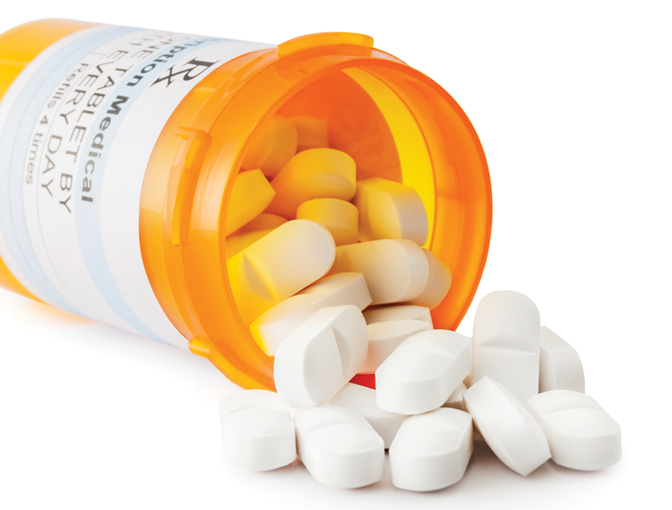
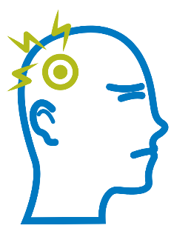

Types of Other Drugs
Feelings of euphoria
Pain relief
Opioids
Drowsiness and sedation
Notes:
Opioids are drugs that treat pain. Opioids are most commonly used in hospitals to treat severe pain and are to be used only under a doctor’s prescription and observation. Examples of opioids prescribed to individuals are Vicodin, OxyContin, Hydrocodone and Morphine and an example of an illegal opioid is heroin. Short term effects of opioid use can include:
(Reveal 1) feelings of euphoria
(Reveal 2) pain relief
(Reveal 3) drowsiness and sedation.
The brain associates the action of taking an opioid medication with a pleasurable reward because it relieves pain. Because the brain is wired to continue to seek out pleasurable actions, a “craving” develops and addiction begins. Once someone is addicted, withdrawal symptoms take over when the brain is “craving” the substance, but is not being rewarded. These symptoms can include, anxiety, inability to sleep, rapid heart beat and high blood pressure.

Slide 36
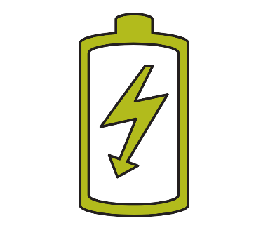
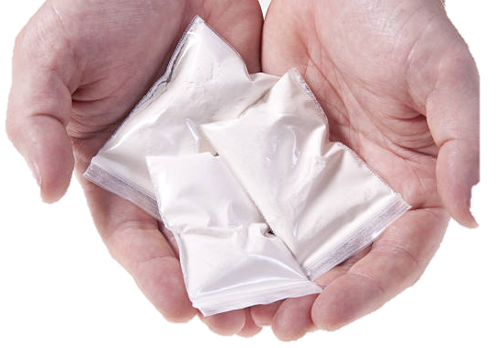

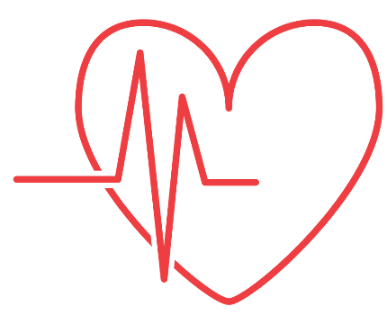
Types of Other Drugs
Increase in energy and alertness
Anxiety and panic attacks
Increase in heart rate and blood pressure
Stimulants
Notes:
A stimulant is a substance that accelerates the activity of the central nervous system. Stimulants can make you feel energetic, focused and alert. Cocaine, amphetamine, methamphetamine, or meth, and Adderall and Ritalin commonly used to treat attention deficit hyperactivity disorder are all examples of stimulants. Drugs like cocaine are highly addictive and affect the brain immediately after use. When using a drug like cocaine, the substance interferes with chemical messengers in the brain and blocks chemicals like serotonin and dopamine from being reabsorbed in the brain. This chemical buildup between nerves causes the “high” feeling. Short-term effects range, but can include:
(Reveal 1) an increasing sense of energy and alertness
(Reveal 2) anxiety and panic attacks
(Reveal 3) increase in heart rate and blood pressure, constricting blood vessels in the brain causing strokes
Other short-term effects include:
Irritability
paranoia
damage to lungs and respiratory system.

Slide 37
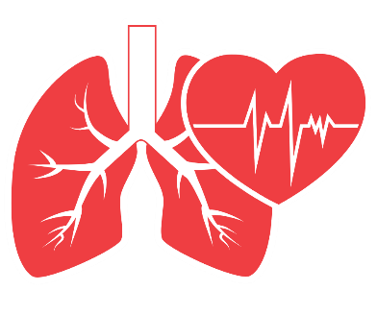
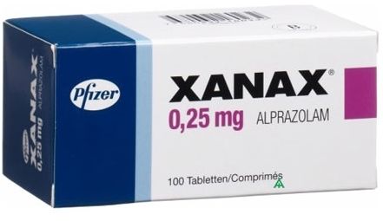

Types of Other Drugs
Slowed pulse and breathing
Poor memory, judgement, concentration and coordination
Depressants
Slurred speech and drowsiness
Notes:
A depressant is a substance that suppresses or slows the activity of the brain and nerves, acting directly on the central nervous system to create a calming effect. Depressants are used both as prescription medications and illicit drugs. Zyprexa, Lorazepam, Xanax and Seconal are examples of depressants prescribed by a doctor but can be misused by taking doses improperly such as taking doses too often. Common short-term effects of depressants include:
(Reveal 1) slowed pulse and breathing
(Reveal 2) poor memory, judgement, concentration and coordination
(Reveal 3) slurred speech and drowsiness
Common long-term effects include: addiction and dependence, or the inability to function without using the substance, chronic sleep problems and respiratory arrest and death. Remember, while many depressants come in pill form, alcohol is also classified as a depressant.

Slide 38

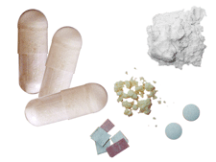

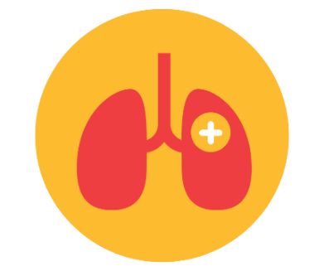
Types of Other Drugs
Hallucinations and distorted perceptions of reality
Increased heart rate, blood pressure and body temperature
Hallucinogens
Shallow breathing
Notes:
Hallucinogens can also be referred to as psychedelics. These types of drugs act on the central nervous system to alter your perception of reality, time and space. Hallucinogenic drugs are best known for how they alter a user’s brain. Additional short-term effects include:
(Reveal 1) hallucinations - They give a distorted perception of the world around you and may cause you to hear or see things that don’t exist or imagine situations that aren’t real. These distorted perceptions can frighten users and even make them act in a strange manner.
(Reveal 2) increased heart rate, blood pressure and body temperature
(Reveal 3) shallow breathing
Other short-term effects include:
dilated pupils
nausea
loss of appetite
Examples of hallucinogens are: LSD, PCP, peyote, MDMA/Molly/ecstasy and psilocybin (found in magic mushrooms).

Slide 39



Types of Other Drugs
Hallucinations, delusions, confusion and euphoria
Slurred speech
Inhalants
Nausea and vomiting
Notes:
Inhalants is a broad class of drugs with the shared trait of being consumed through inhaling fumes. Most of the substances in this class exist in vapor form and can be found in many household items such as paint and paint thinners, glue and markers and pens. The method of abuse may vary but can include sniffing, spraying, huffing, bagging and inhaling. There are many effects of using inhalants. Short-term effects of inhalant use include:
(Reveal 1) hallucinations, delusions, confusion and euphoria
(Reveal 2) slurred speech
(Reveal 3) nausea and vomiting
Extended use of inhalants can cause tiredness, weight loss, memory loss, loss of sense of smell and heart damage to name a few.

Slide 40



Types of Other Drugs
Increased heart rate and shallow breathing
Dizziness and slow reaction time
Cannabis
Red eyes and dilated pupils
Notes:
Cannabis or marijuana is a plant-derived drug that is the most commonly used illicit drug worldwide. There are multiple ways to consume marijuana including inhalation through smoking, oral ingestion, topical and vaping through an electronic cigarette. Short-term effects of marijuana use are:
(Reveal 1) increase your heart rate and shallow breathing
(Reveal 2) dizziness and slowed reaction time
(Reveal 3) red eyes and dilated pupils
If you drive after using marijuana, your risk of being in a car accident more than doubles. Long time users can have withdrawal symptoms such as craving, irritability and sleeplessness. Marijuana is not it’s own classification like opioids, stimulants, depressants, hallucinogens and inhalants. According to the University of Maryland, cannabis can be classified as a depressant, stimulant or a hallucinogen.
While marijuana is legal in some states for medical and recreational use, federally, marijuana use is against the law.

Slide 41
FLASH FACTS
5.5% of high schoolers reported trying marijuana for the first time before they
were 13 years old.
Notes:
According to the CDC, 5.5% of high schoolers reported trying marijuana for the first time before they were 13 years old.
Encourage discussion among your students. Did they know this; do they think it’s higher or lower?

Slide 42
Long-term Effects of Other Drug Use
Those who use drugs over an extended period of time put themselves at risk of the following long-term effects.
Depression
Psychosis
Paranoia
Schizophrenia
Anxiety
Weight loss
Malnutrition
Sleep problems
Lung disease
Cardiovascular disease
Cancer
Stroke
Hepatitis
HIV and AIDS
Notes:
All drugs have varying long-term side effects. Those who use drugs over an extended period of time put themselves at risk of the following:
Depression
Psychosis
Paranoia
Schizophrenia
Anxiety
Weight loss
Malnutrition
Sleep problems
Lung disease
Cardiovascular disease
Cancer
Stroke
Hepatitis
HIV and AIDS

Slide 43
The Brain’s Reaction to Opioids
Watch Here
Notes:
Play video

Slide 44
FLASH FACTS
4.9% of middle schoolers reported taking prescription pain medicine without a doctor’s prescription or differently than how the doctor told them to use it.
Notes:
According to the CDC, 4.9% of middle schoolers reported taking prescription pain medicine without a doctor’s prescription or differently than how the doctor told them to use it.
Encourage discussion among your students. Did they know this; do they think it’s higher or lower?

Slide 45
SPARK A DISCUSSION
What are ways that improper prescription use can be limited?
Notes:
Ask students the following prompt: ‘What are ways that improper prescription use can be limited?”
Allow students to share answers before moving onto the next slide.

Slide 46
Virginia Law
In the state of Virginia, it is illegal for an individual to knowingly possess a controlled substance obtained without a valid prescription or through authorized means.
Each classification of drugs has a different set of penalties ranging n misdemeanors with consequences of jail time and/or fines to felonies with consequences of prison and/or fines.
Notes:
In the state of Virginia, it is illegal for an individual to knowingly possess a controlled substance obtained without a valid prescription or through authorized means. This includes all classifications of drugs reviewed in this training.
Each classification of drugs has a different set of penalties ranging in misdemeanors with consequences of jail time and/or fines to felonies with consequences of prison and/or fines.

Slide 47

SUBSTANCE USE INFLUENCES
Notes:
Youth are exposed to many environments and situations that can influence their decision to use substances. We are going to review what individual, family, and community factors can influence youth substance use.

Slide 48





Risk Factors
Risk factors are aspects that make it more likely that an
individual will experience a problem.
Lack of parental supervision and child neglect
Academic problems
Undiagnosed mental health problems
Peer substance use and drug availability
Poverty
Notes:
Risk factors are aspects that make it more likely that an individual will experience a problem, in this case, youth substance use. An example is: if a person smokes, that is a risk factor for having a heart attack.
Individual aspects of a person, their environment and their life experience influence their risk factors. Negative influences contribute to risk factors and the likelihood of youth substance use. Examples of risks factors include: (Reveal 1) lack of parental supervision and child abuse and neglect, (Reveal 2) academic problems, (Reveal 3) undiagnosed mental health problems, (Reveal 4) peer substance use and drug availability and (Reveal 5) poverty. Having one or more of the risk factors in the following slides does not mean someone will become addicted to substances or will misuse substances, but it does mean the odds are greater that they will.

Slide 49
Risk Factors – Individual
Poor impulse control
Low harm avoidance
Sensation seeking
Lack of behavioral self-control
Aggressiveness
Anxiety
Genetics
Depression
Hyperactivity/ADHD
Antisocial behavior
Early persistent problem behaviors
Early substance use
Notes:
There are three subcategories of risk factors; the first subcategory of risk factors we will discuss is Individual – what traits does an individual have that make them more likely to use substances. The traits are: poor impulse control, where someone may be in able to not speak on a thought or the inability to not exhibit a behavior or action; low harm avoidance, when someone may not be fearful or doubt their actions; sensation seeking or searching for a thrill that may give them a rush of adrenaline; lack of behavioral self-control or the inability to control their behaviors; aggressiveness; anxiety; genetics; depression; hyperactivity or Attention Deficit Hyperactivity Disorder (also known as ADHD); antisocial behavior or actions that may harm or lack consideration for the well-being of others; early persistent problem behaviors and early substance use. Each of these individual risk factors are associated with an increased likelihood of youth substance use and abuse.

Slide 50
Risk Factors – Family
Permissive parenting
Parent-child conflict
Inadequate supervision
Low parental warmth
Lack of or inconsistent discipline
Parental hostility
Harsh discipline
Low parental hopes for child
Child abuse/maltreatment
Substance use among parents and/or siblings
Parental favorable attitudes toward alcohol and/or drugs
Notes:
The second subcategory of risk factors we will discuss is related to the family structure and system – what traits does a family have that make them more likely to use substances. They are: permissive parenting – when parents are very loving but provide few guidelines and rules; parent-child conflict – when both the parent and the child display negative behaviors; inadequate supervision by parents leaving young children unattended or with improper childcare; low parental warmth or emotional connection; lack of, or inconsistent discipline by parents; parental hostility or a pattern of behaviors that interferes with the relationship between a child and their parent; harsh discipline; low parental hopes and goals for a child exhibited through goal development and set expectations; child abuse or maltreatment; substance use among parents or siblings; and parents having favorable attitudes toward alcohol and other drug use.

Slide 51
Risk Factors – School, Peers, Community
School failure to meet a set of standards
Low commitment to school
Accessibility/availability of resources
Peer rejection
Laws and norms favorable towards use
Deviant peer group
Peer attitudes toward drugs
Alienation within the community
Accessibility/availability of substances
Extreme poverty for those children antisocial in childhood
Notes:
The third subcategory of risk factors we will discuss includes school, peers and community – what traits exist in the community that make them more likely to use substances. They are: school failure to meet a set of standards to be accredited and offer services needed by students; low commitment to school from the community, accessibility or availability of community resources and services for life skill development, substance use treatment and other social services; peer rejection or children purposely excluding and hurting other children; laws and norms favorable towards substance use which means that accountability and consequences for participating in illegal substance use are minimal; membership in a deviant peer group such as a gang; peer attitudes towards drugs are favorable and encourage the behavior; personal alienation between members of the community due to lack of common values; accessibility or availability of substances; and extreme poverty for those children who were antisocial in childhood .

Slide 52
SPARK A DISCUSSION
There are many risk factors, or factors that can impact someone negatively, that can lead to substance use. How do you think individual’s who are exposed to these factors can overcome and not fall to substance use?
Notes:
Ask students the following prompt: “There are many risk factors, or factors that can impact someone negatively, that can lead to substance use. How do you think individual’s who are exposed to these factors can overcome and not fall to substance use?”
Allow them to share answers before moving onto the next slide.

Slide 53


Protective Factors
Risk factors are aspects that make it more likely that an
individual will experience a problem.
Parental support and involvement
A healthy community
Strong community support
Notes:
Protective factors are aspects that make it less likely that an individual will experience a problem, in this case, youth substance use. An example is: if a person walks two miles a day, that is a protective factor from having a heart attack.
Positive influences from the environment, life experiences and individual aspects of a person contribute to protective factors that can keep youth from using substances. The presence of protective factors does not mean that there are no risk factors, rather that they may reduce the negative affect of risk factors. Examples of protective factors are: (Reveal 1) parental support and involvement and (Reveal 2) a “healthy” community that has accessible services and (Reveal 3) strong community support.

Slide 54
Protective Factors – Individual & Family
Individual
Mastery of academic skills
Following rules for behavior at home, at school and in public places
Ability to make friends
Good peer relationships
Family
Consistent discipline
Conversation-based discipline, rather than physical discipline
Extended family support
Notes:
The following information addresses protective factors specifically for middle school students as influenced by two subcategories of personal and family traits that can lead an individual to make positive behavior choices.
Individual traits include: mastery of academic skills, following rules for behavior at home, at school and in public places, the ability to make friends, and good peer relationships.
Family traits include: consistent discipline from parents, conversation-based discipline rather than physical discipline, and extended family support from grandparents, aunts and uncles.

Slide 55
Protective Factors – School, Peers, Community
Healthy peer groups
School engagement with students
Effective classroom management
High academic standards
Positive partnering between school and family
School policies and practices to reduce bullying
Notes:
The following information addresses protective factors specifically for middle school students as influenced by the subcategory of school, peers, and community influences.
Traits of a community that can influence individual positive behaviors are: healthy peer groups – youth have friends that are making good choices; school engagement with students – there is a well rounded effort within the school to engage students during and after school hours; effective classroom management by educators; high academic standards are established at the community level; positive partnering between the school and family – everyone is on the same page; and school policies and practices to reduce bullying.

Slide 56
SPARK A DISCUSSION
What are reasons teens choose not to use substances?
Notes:
Ask students the following prompt: “What are reason teens choose not to use substances?”
Allow them to share answers before moving onto the next slide.

Slide 57




Refusal Skills
Refusal skills are a set of skills designed to help youth
avoid participating in high-risk behaviors.
Say “no”
Tell why not
Offer another idea
Promptly leave
Notes:
If you use alcohol and drugs, you are more likely to take risks that can lead to serious injuries and dangerous situations. As you get older, your friends or others might pressure you to try alcohol or other drugs. Negative peer pressure is when you feel forced by others to do something you normally wouldn’t do; however, it’s important to stand up for your self and do what you know is right. Refusal skills can help you say no to negative peer pressure.
Refusal skills are a set of skills designed to help youth avoid participating in high-risk behaviors such as drinking alcohol or using other drugs. The following acronym will help you prepare to refuse pressure to use substances:
S – Say “no.” When saying “no,” use a firm voice, don’t hesitate and look directly at the person.
T – Tell why not. Let them know why you do not want to participate. Honesty is good and it may influence your peers to change their minds as well.
O – Offer another idea. These are referred to as alternate activities. What is something fun that you and your friends could do that doesn’t involve alcohol or other drugs?
P – Promptly leave. If your refusal doesn’t go well and you’re still being pressured, leave. There is no harm in leaving the situation.

Slide 58

SUBSTANCE USE DISORDER
Notes:
In this next section we are going to discuss what substance use disorder is.

Slide 59



What is Substance Use Disorder?
A disease that affects a person’s brain and behavior and leads to an inability to control their use of a legal or illegal drug or medication.
Notes:
According to the Mayo Clinic, Substance Use Disorder is a disease that affects a person’s brain and behavior and leads to an inability to control their use of a legal or illegal drug or medication. Substance Use Disorder, or SUD, is the medical term for addiction, substance abuse and alcoholism. All of the substances we’ve covered in this training can lead to an individual having substance use disorder.
Did you know, teens who begin drinking before the age of 15 are five times more likely to develop alcohol dependence or abuse in their life than those who begin drinking at the age of 21 or older? As we previously discussed, the brain is not fully developed until your mid-twenties; early substance use can interfere with brain growth and development and can lead to a dependence on substances.
Genetics, or family history, can influence someone having SUD. People with family members who had SUD have a greater chance of developing an addiction, but this does not guarantee that someone will develop SUD. Those other risk factors we discussed also can lead an individual toward a substance use disorder diagnosis.

Slide 60
How does Substance Use Disorder begin?
Substance use addiction can start with experimental use
Some drugs have a higher risk and cause addiction more quickly
Individuals with Substance Use Disorder may need a drug to feel good and to go about their day to day activities
Unhealthy use of substance can be recognized by:
  Problems at school or work
  Physical health issues
  Neglected appearance
  Changes in behavior
  Money issues
Notes:
(Reveal 1) According to the Mayo Clinic, drug addiction can start with experimental use of recreational drugs in social settings. For some people, this use becomes more frequent leading to addiction. For other individuals, drug addiction, particularly opioids, begins with exposure. This could be exposure from prescribed medication or from receiving medication from a friend or relative who has been prescribed.
The risk of addiction varies by drug. (Reveal 2) Some drugs have a higher risk and cause addiction more quickly than others. As time goes on, individuals may need larger doses of the drug to feel its effects. (Reveal 3) This can lead individuals to needing the drug to feel good and that it is difficult to go without the drug in their system. Individuals who may attempt to stop their drug use may face intense cravings for the drug and may face other withdrawal symptoms.
(Reveal 4) Unhealthy use of drugs can be recognized through the following possible indications:
(Reveal 5) Problems at school or work: missing classes or shifts, a disinterest in extracurricular activities and a decline in grades or work performance.
(Reveal 6) Physical health issues: lack of energy or motivation, a change in weight, red eyes
(Reveal 7) Neglected appearance: poor grooming habits and lack of interest in clothing or looks
(Reveal 8) Changes in behavior: private and protective of their bedroom, secretive of plans with friends, or changes in relationships with family and friends
(Reveal 9) Money issues: Asks for money without explanation and missing money or items from around the home that may be used to support drug use
If you believe that a friend may being using substances and/or has an unhealthy relationship with alcohol, tobacco or other drugs, it is important to notify a trusted adult of your concerns.

Slide 61

BYSTANDER INTERVENTION
Notes:
Start by asking the class: “do you know what a bystander is?”
A bystander is a person who witnesses a conflict or an incident, but does nothing to stop the situation or help the person in trouble. An active and empowered bystander takes action when they witness a person in need. Rather than stepping aside and doing nothing, an active bystander intervenes with the goal of helping the other person.

Slide 62
Bystander Intervention
Notice the event
Determine whether the event is a problem or an emergency and how you can safely respond
Assume responsibility
Come up with a plan
Take action to protect yourself and others
Notes:
Before a risky situation occurs, there are clues that something may be getting out of hand. Intervening before imminent harm can reduce the likelihood of violence. Warning signs can include excessive drinking, verbal arguments and body language signaling that someone is uncomfortable.
Five Steps to Being an Active Bystander:
(Reveal 1) Notice the event – an event can look differently in every situation. An event could be when you notice that your friend is hanging out with a group of students that don’t make positive choices and could be leading your friend down a dangerous path. Be aware of your surroundings at all times. There are many distractions that can make it easy to not notice when something is wrong. Try your best to stay alert in all settings so you can pick up on anything that could potentially turn into an unsafe situation.
(Reveal 2) Determine whether the event is a problem or an emergency and how you can safely respond – In the situation we just referenced, this event is not an emergency. It is a problem. Regardless, you want to respond in a safe manner. Avoid the bystander effect. Studies have shown that the greater the number of people present, the less likely people are to help a person in distress. If you witness an emergency situation, don’t wait to see if others around you will respond before intervening.
(Reveal 3) Assume responsibility – as this person’s friend and as someone who noticed their behavior and the behaviors of the group of students they’re around, it is your responsibility to take action. Don’t be afraid to be the first person to step in and take responsibility. Remember that safety begins with you.
(Reveal 4) Come up with a plan – this plan does not have to revolve around you taking immediate action. Carefully consider the situation before taking any action and never put yourself in danger. The plan could include talking to your friends parents, a teacher or school counselor and sharing your concern. They may have also noticed this or if not, they will thank you for bringing it to their attention. The adult will know how to properly respond to your friend’s actions. There are different ways in which you can intervene.
(Reveal 5) Take action to protect yourself and others – No matter what the situation is, you must protect yourself and others. You do not want yourself or other people to get hurt because you are trying to help someone else. This is why it is important to involve an adult.
In emergencies, it is important to call 911. Emergencies may include: alcohol poisoning, injuries related to alcohol or other drug use as well as impaired driving.

Slide 63

How to be an Active Bystander
Directly Intervene
  Directly intervene in the moment to prevent a problem from occurring.
Delegate
  Don’t hesitate to ask a friend or a peer to help you out.
Distract
  Interrupt the situation without directly confronting the harmful behavior.
Notes:
(Reveal 1) Directly intervene in the moment to prevent a problem from occurring. This can look like asking someone who looks uncomfortable in a situation, “Are you doing okay?”
(Reveal 2) Delegate: Seek assistance from someone else, whether a peer or police officer. If you feel uncomfortable acting alone, don’t hesitate to ask a friend or a peer to help you out.
(Reveal 3) Distract: Interrupt the situation without directly confronting the harmful behavior. If it appears that someone is taking advantage of a person who has been drinking, distract the offender by interrupting the situation. Even if you don’t know the person, interject by saying “Hey, I was looking for you!” Be creative! At this time, you should also plan to call 911.

Slide 64




Resources You Can Rely On
Parents
Teachers and coaches
Police Officers
Doctors and nurses
Notes:
In all situations that involve substances, you should communicate this to a trusted adult. Trusted adults may be different for each individual, but examples are:
(Reveal 1) parents – whether this is your own set of parents, or a friends
(Reveal 2) teachers and coaches – these are people who care for you and want to see you succeed
(Reveal 3) police officers – this may be your school’s resource officer or even a police officer that lives in your community
(Reveal 4) doctors and nurses – you can ask your doctor questions and share information with them confidentially

Slide 65

Questions?
Notes:
Be sure to ask the class if they have any questions. If you are unsure on where to direct your students to answer, please feel free to reach out to Virginia ABC Education and Prevention at 804-977-7440 or at education@abc.virginia.gov.

Slide 66

This training is a part of the Virginia ABC Being Outstanding Leaders Together Against Drugs and Alcohol (BOLT) program
Virginia ABC Education and Prevention
www.abc.virginia.gov/education
education@abc.virginia.com
(804) 977-7440
VirginiaABCEducationAndPrevention
Notes:
Thank you for facilitating the Alcohol, Tobacco and Other Drugs training for middle school students. We hope that this material was useful and tat you were able to integrate it into your curriculum. Should you have any additional questions or concerns please contact Virginia ABC Education and Prevention at education@abc.virginia.com or call 804-997-7440. For updates and more information on our programs, like us on Facebook at Virginia ABC Education and Prevention.

