Slide 1
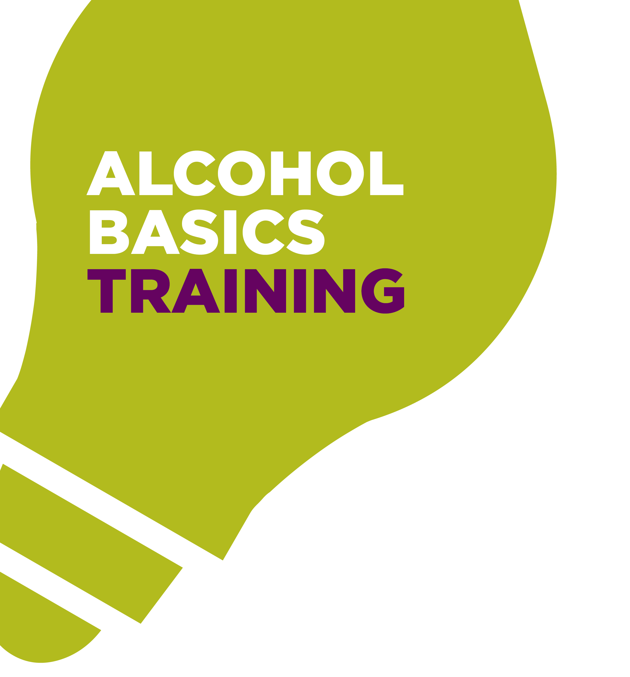


Slide 2
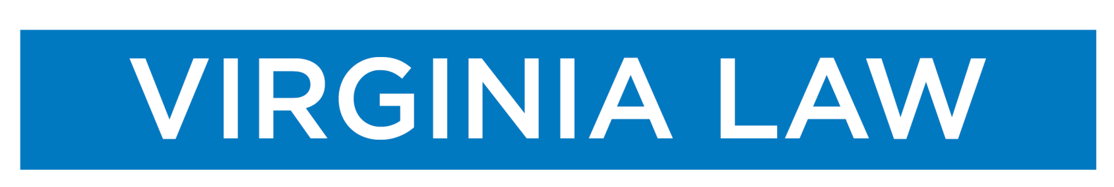
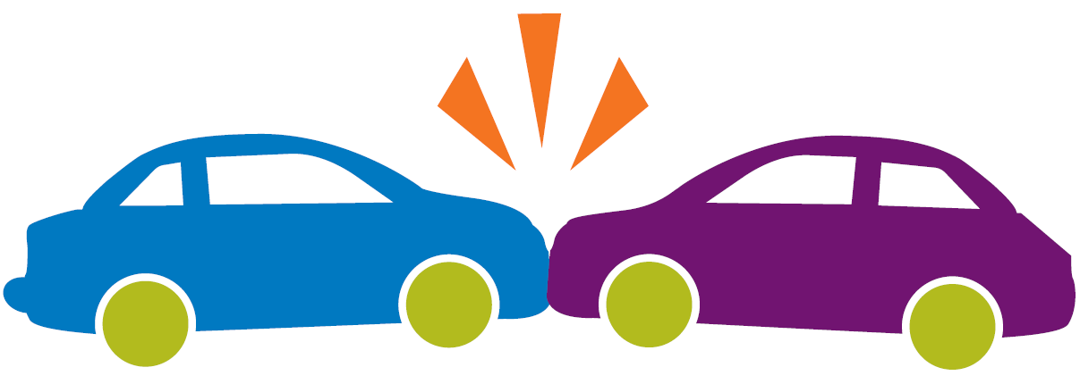
The Commonwealth of Virginia’s Zero Tolerance Law makes driving while intoxicated by any amount of alcohol a serious criminal offense for drivers younger than 21. Virginia defines the legal limit for driving while intoxicated at a BAC of 0.08% for those 21 years of age and older.
Notes:
The Commonwealth of Virginia’s Zero Tolerance Law makes driving while intoxicated by any amount of alcohol a serious criminal offense for drivers younger than 21. Virginia defines the legal limit for driving while intoxicated at a blood alcohol concentration (BAC) of 0.08% for those 21 years of age and older.

Slide 3
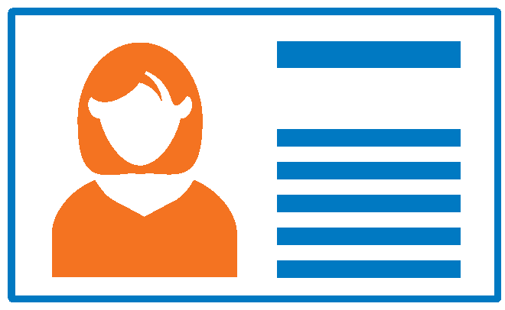

It is illegal for anyone under 21 to possess any alcoholic beverage.
It is illegal to create, loan, sell or use a fake ID.
A conviction for possessing or using a fake ID could appear on your permanent criminal record.
Notes:
It is illegal to use another’s identification as one’s own.
It is illegal to possess or sell an ID for the purpose of establishing a false identification.
Persons who possess, use or distribute fake IDs are charged with a Class 1 misdemeanor.

Slide 4
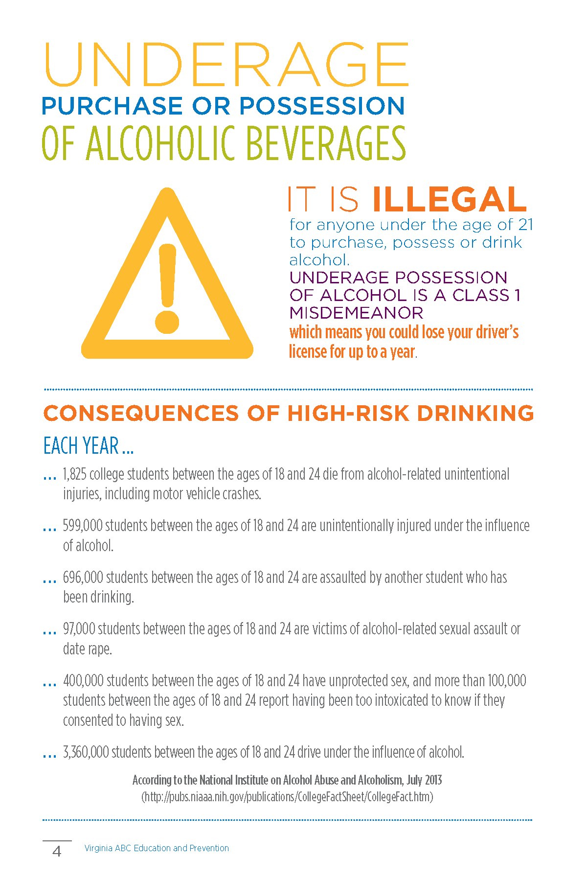
It is illegal for anyone under the age of 21 to purchase, possess or drink alcohol.
Underage possession is a Class 1 Misdemeanor and could result in losing your driver’s license for up to a year.
Notes:
It is illegal for anyone under the age of 21 to purchase, possess or drink alcohol. Additionally, purchasing or providing alcohol to anyone under the age of 21 is illegal and also known as social providing.
Underage possession is a Class 1 misdemeanor and could result in losing your driver’s license for up to a year.

Slide 5
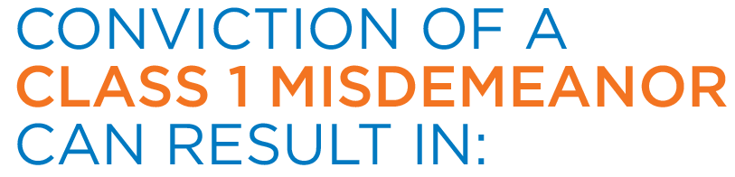
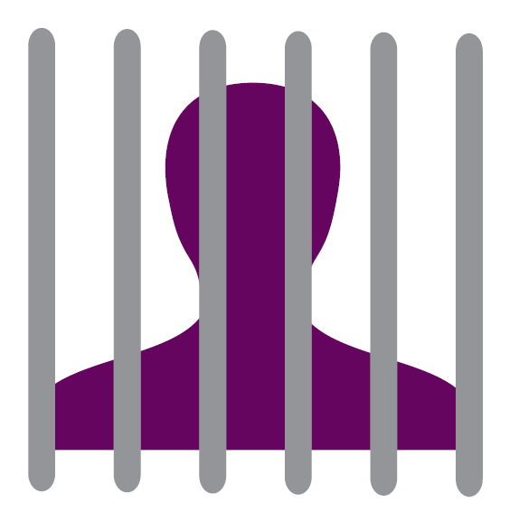
Loss of driver’s license for up to one year
    • and/or fines up to $2,500
    • and/or 50 hours of community service
    • and/or up to one year in jail
Notes:
Conviction of a Class 1 misdemeanor can result in:
Loss of driver’s license for up to one year
• and/or fines up to $2,500
• and/or 50 hours of community service
• and/or up to one year in jail

Slide 6
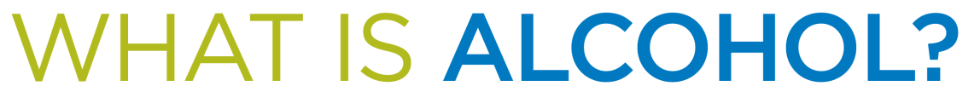
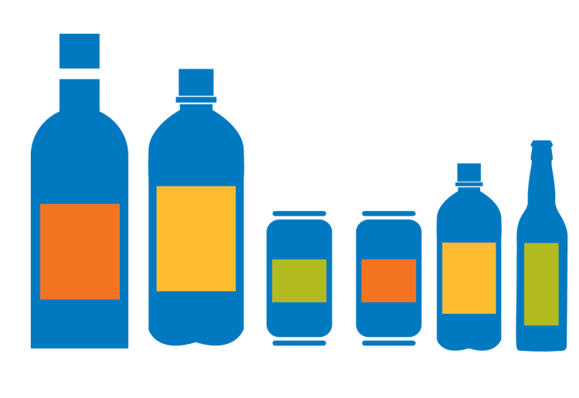
Alcohol is created naturally when sugars in grains, vegetables and fruits are fermented.
Distilled spirits or liquors go through an additional process of evaporation and condensation.
Notes:
Alcohol is created naturally when sugars in grains, vegetables and fruits are fermented. Distilled spirits or liquors go through an additional process of evaporation and condensation.

Slide 7
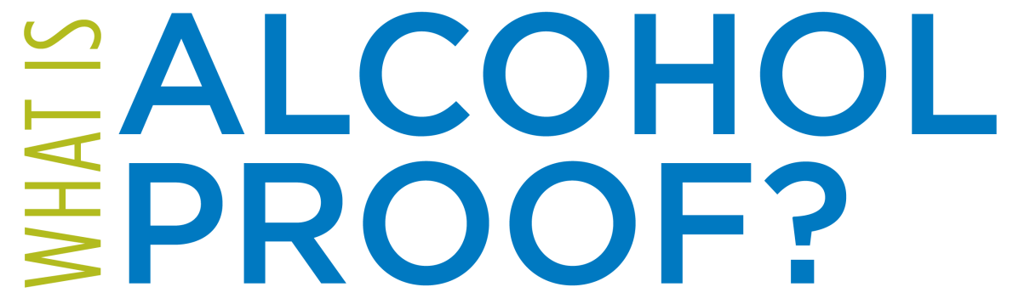

Alcohol proof defines how much alcohol content a beverage contains.
A beverage’s alcohol by volume (ABV) percentage can often be located on the bottle, can or menu.
Notes:
Alcohol proof defines the alcohol content of a beverage. Alcohol proof for distilled spirits is equal to twice the percentage of alcohol content by volume. For example, a standard 1.5 ounce serving of liquor that is 80 proof contains 40% alcohol by volume, also known as ABV.
The proof of bottled distilled spirits and the ABV percentage of bottled or canned beer, wine and other types of alcoholic beverages can be located on the bottle or can. ABV’s of beer and wine at restaurants and other establishments can often be located on the menu.

Slide 8
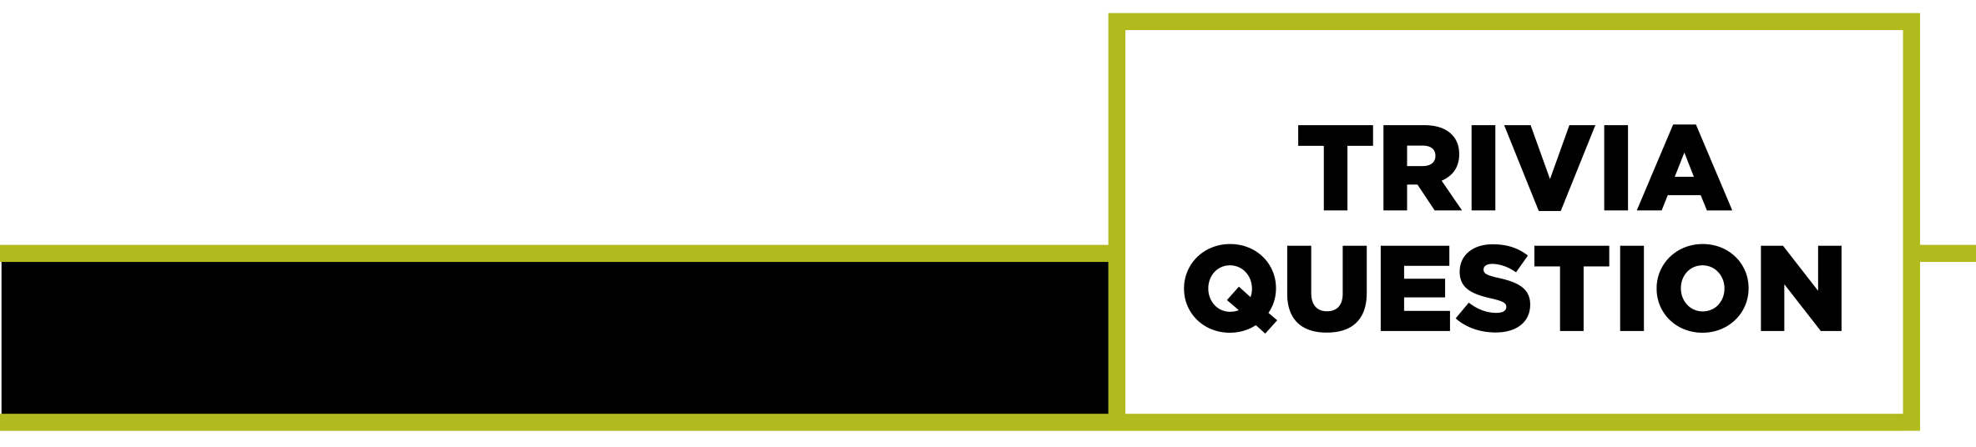
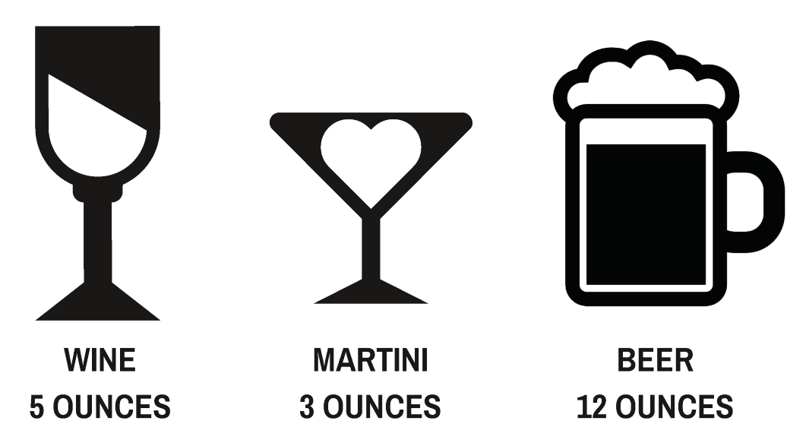
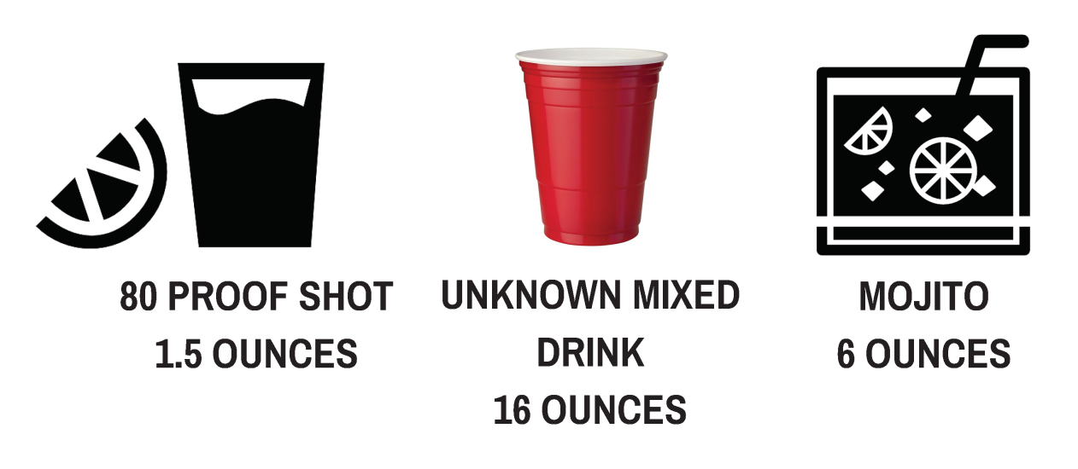
Which drinks are equivalent to a standard size drink?
Notes:
Trivia Question: Which drinks are equivalent to a standard size drink?
Standard size drinks contain approximately the same amount of alcohol and are helpful in estimating blood alcohol concentration (BAC).
Answer: 5 ounces of wine, 12 ounces of beer and 1.5 ounces of an 80 proof shot of liquor.

Slide 9
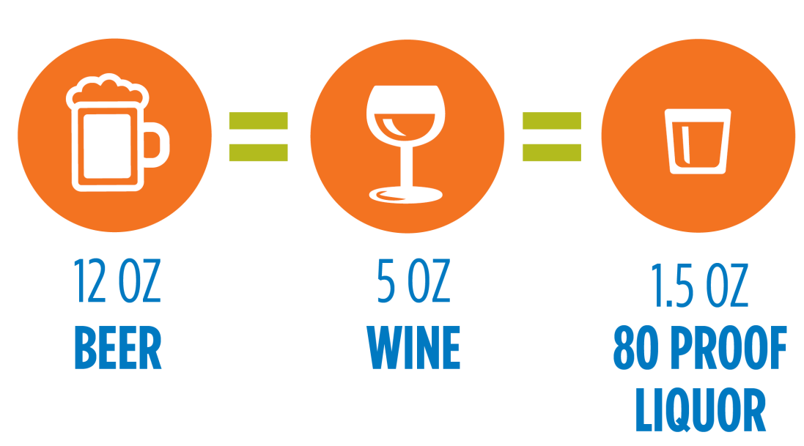
Standard drinks contain approximately the same amount of alcohol and are helpful in estimating blood alcohol concentration (BAC).
Notes:
Standard drinks contain approximately the same amount of alcohol and are helpful in estimating blood alcohol concentration (BAC). This means that 12 ounces of beer, 5 ounces of wine and 1.5 ounces of 80 proof liquor all contain approximately the same amount of alcohol.

Slide 10
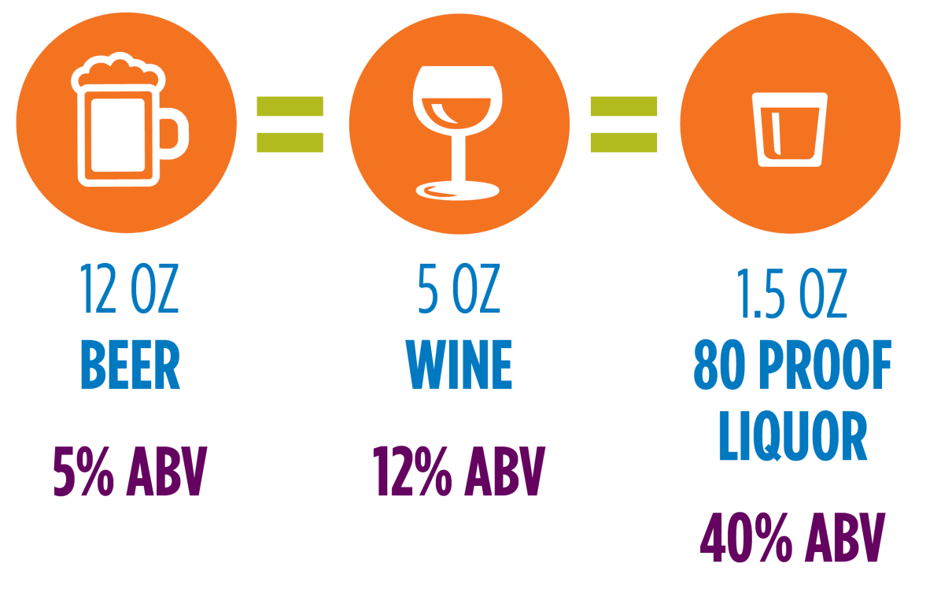
The liver typically processes one standard size drink per hour.
Alcohol is not always served in the same size constraints of a standard drink.
Notes:
Why is it important to understand what a standard size drink is and what a beverage’s ABV means? The liver typically processes one standard size drink per hour. Additionally, alcohol is not always served in the same size constraints of a standard drink. The ABV in craft beers, wines, liquors and mixed drinks are not always equivalent to the ABV of a standard drink.
For example, let’s look at the ABVs of standard size drinks. A standard 12 ounce beer has a 5% ABV, while 5 ounces of wine contains a 12% ABV and 1.5 ounces of 80 proof liquor contains a 40% ABV.

Slide 11
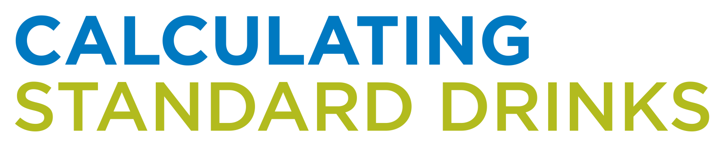
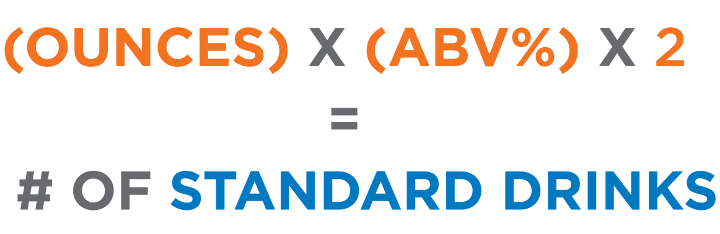
Example: You order a 16 ounce beer that has a 9% ABV. How many standard drinks are you consuming?
Notes:
Since alcohol is not always created equal, knowing how to calculate how many standard drinks a beverage contains can be helpful. To calculate the amount of standard drinks being consumed, multiply the number of ounces in the drink by the ABV percentage decimal. Then, multiply that number by two to find the approximate number of standard drink sizes the beverage contains.
For example, you order a 16 ounce beer that has a 9% ABV. How many standard drinks are you consuming?
Give your students a few minutes to calculate the answer. Then walk through the answer step by step with them on the next slide.

Slide 12
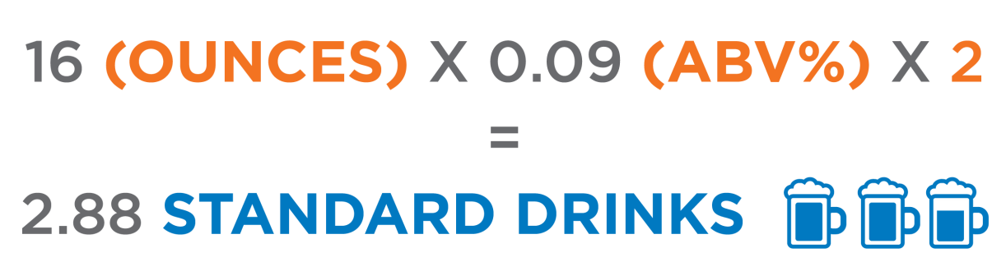
Example: You order a 16 ounce beer that has a 9% ABV. How many standard drinks are you consuming?
Notes:
For example, you order a 16 ounce beer that has a 9% ABV. How many standard drinks are you consuming? 16 ounces multiplied by the 0.09 ABV% multiplied by 2 equals approximately 2.88 standard drinks.
Reflect with your students about how drinking one beer can have the same impact as drinking almost three standard beers. Discuss how long it might take for the liver to process one 16 ounce beer, keeping in mind that the liver processes one standard size drink per hour.

Slide 13

What impacts the way a person responds to alcohol?
Notes:
What impacts the way a person responds to alcohol?

Slide 14
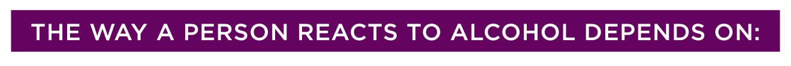
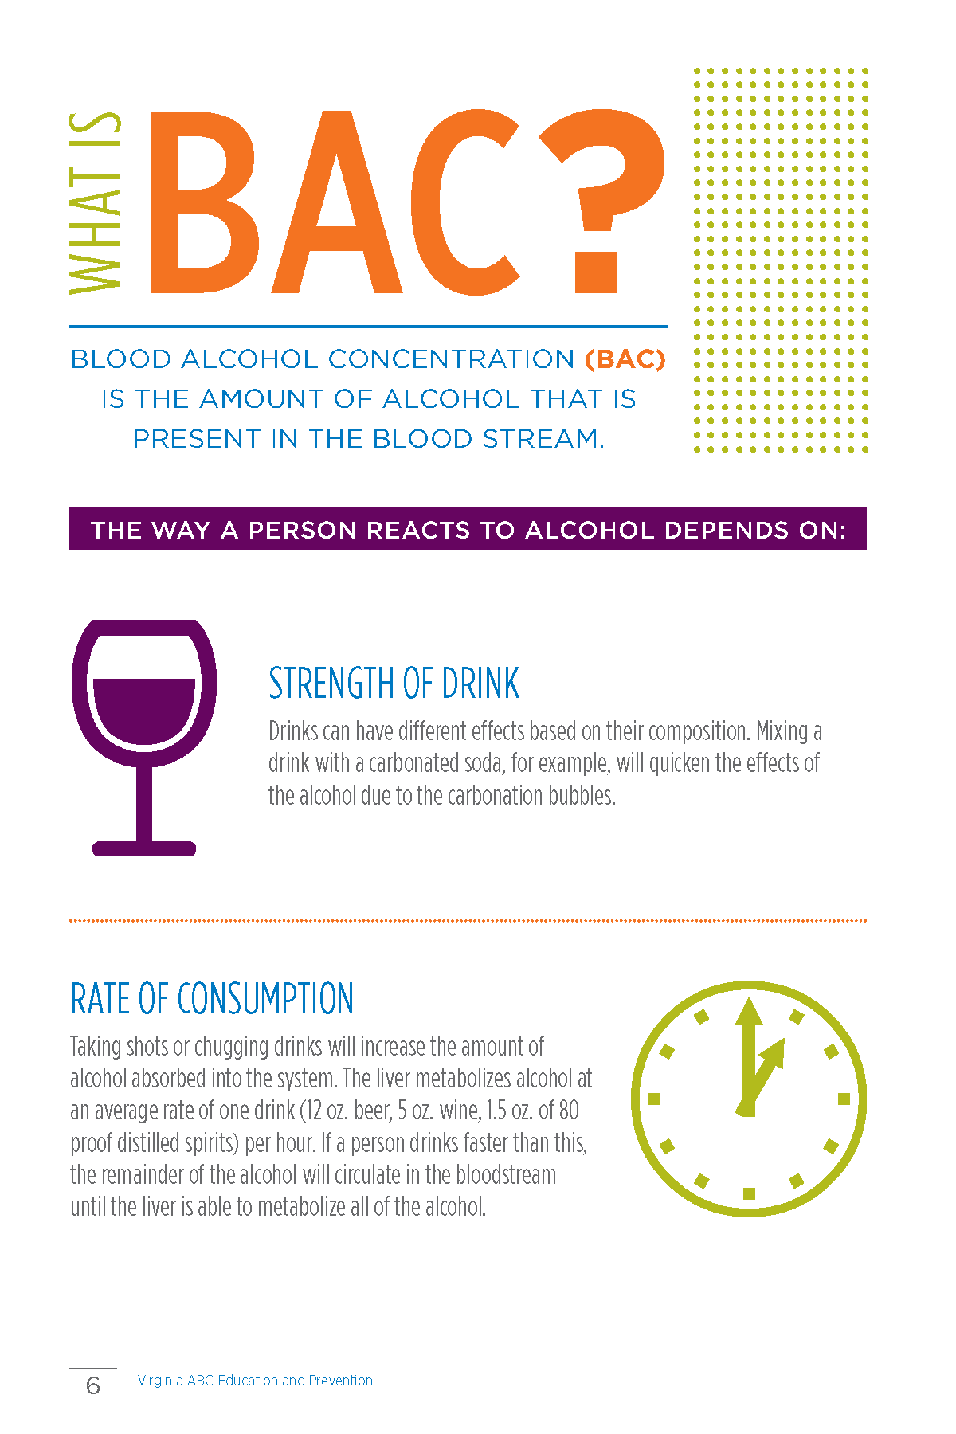
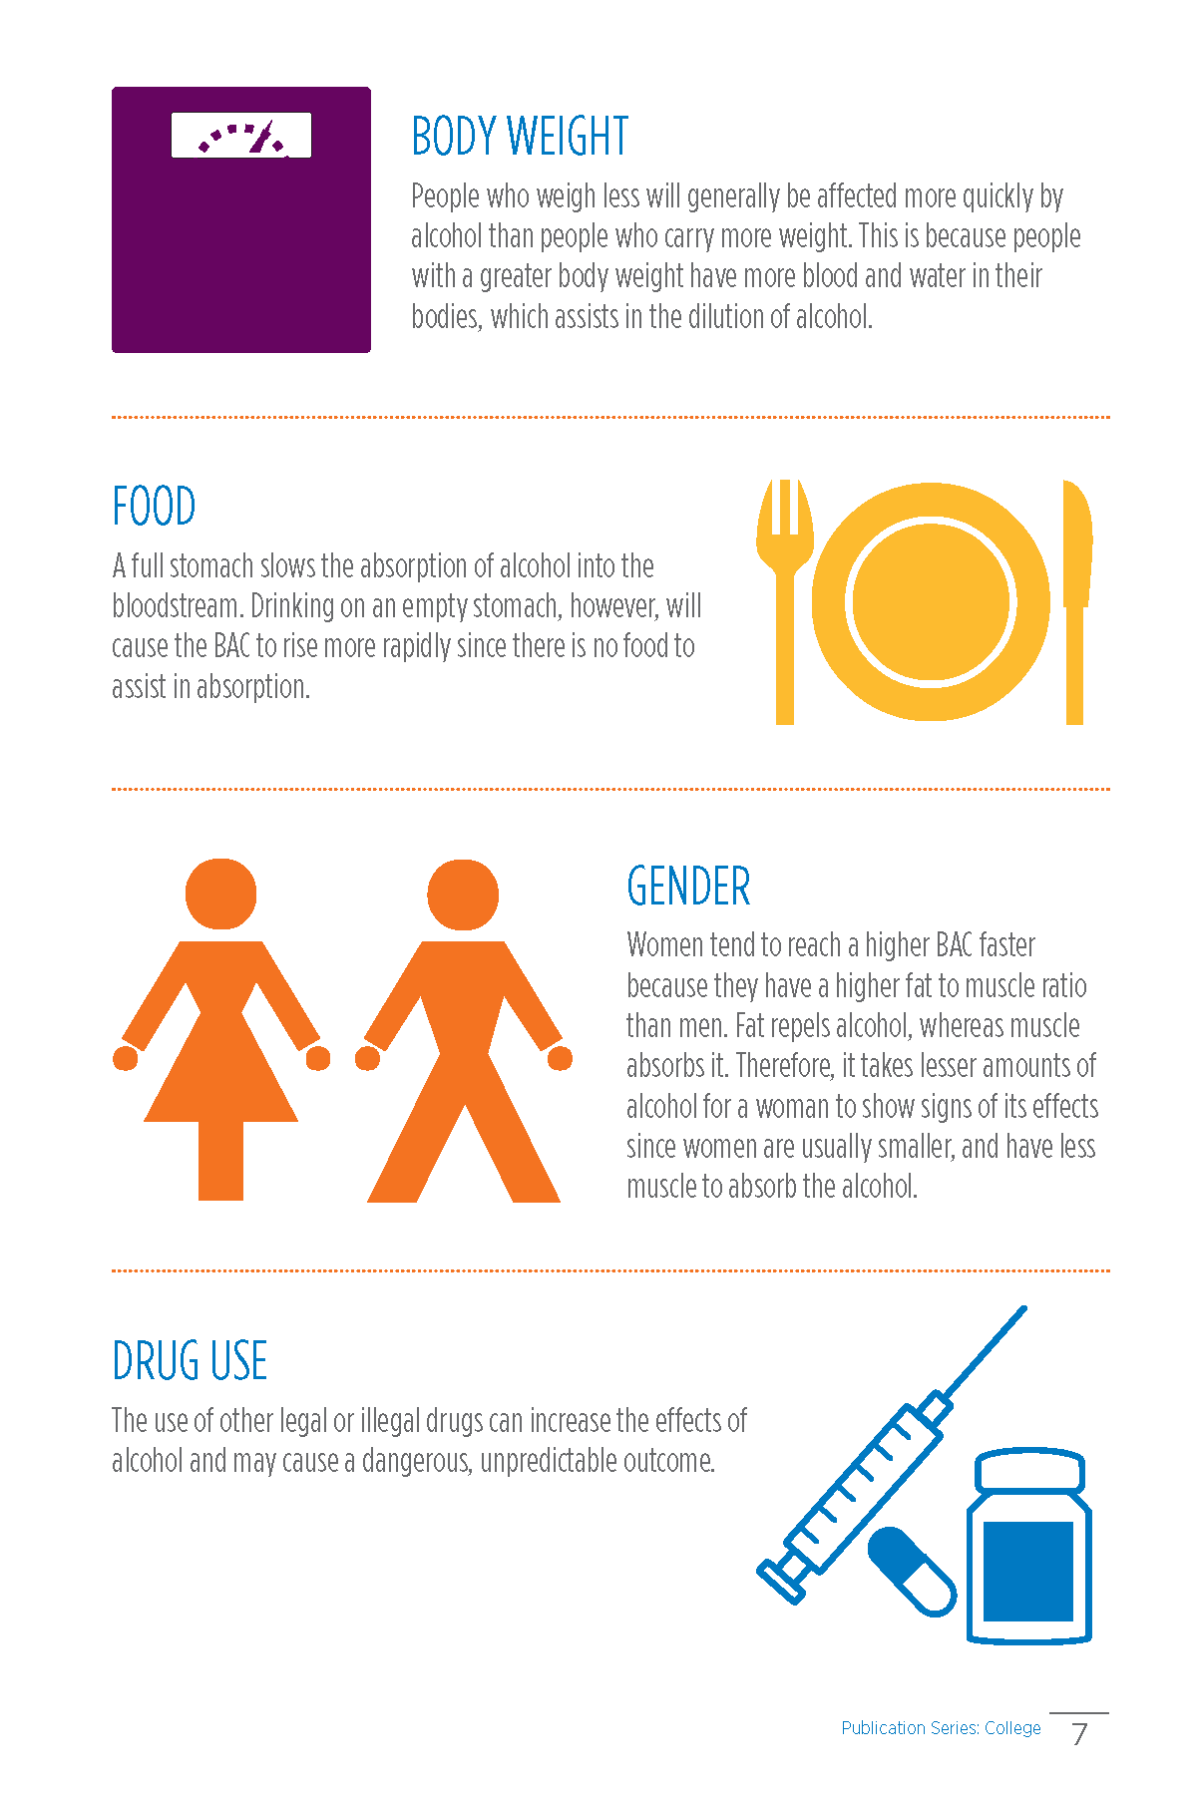
Strength of drink
Rate of Consumption
Gender
Body Weight
Food
Drug Use
Notes:
The way a person reacts to alcohol depends on:
Strength of drink: Drinks can have different effects based on their composition. Mixing a drink with a carbonated soda, for example, will quicken the effects of the alcohol due to the carbonation bubbles.
Rate of Consumption: Taking shots or chugging drinks will increase the amount of alcohol absorbed into the system. The liver metabolizes alcohol at an average rate of one drink (12 oz. beer, 5 oz. wine, 1.5 oz. of 80 proof distilled spirits) per hour. If a person drinks faster than this, the remainder of the alcohol will circulate in the bloodstream until the liver is able to metabolize all of the alcohol.
Gender: Women tend to reach a higher BAC faster because they have a higher fat to muscle ratio than men. Fat repels alcohol, whereas muscle absorbs it. Therefore, it takes lesser amounts of alcohol for a woman to show signs of its effects since women are usually smaller, and have less muscle to absorb the alcohol.
Body Weight: People who weigh less will generally be affected more quickly by alcohol than people who carry more weight. This is because people with a greater body weight have more blood and water in their bodies, which assists in the dilution of alcohol.
Food: A full stomach slows the absorption of alcohol into the bloodstream. Drinking on an empty stomach, however, will cause the BAC to rise more rapidly since there is no food to assist in absorption.
Drug Use: The use of other legal or illegal drugs can increase the effects of alcohol and may cause a dangerous, unpredictable outcome.

Slide 15
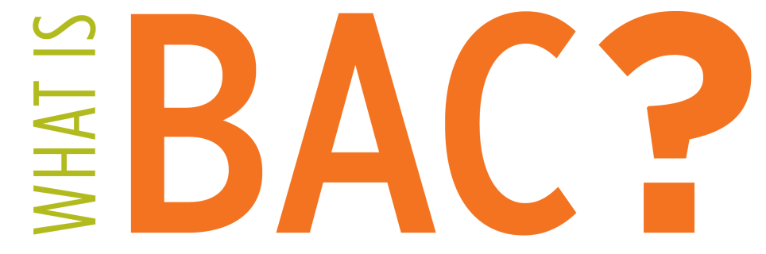
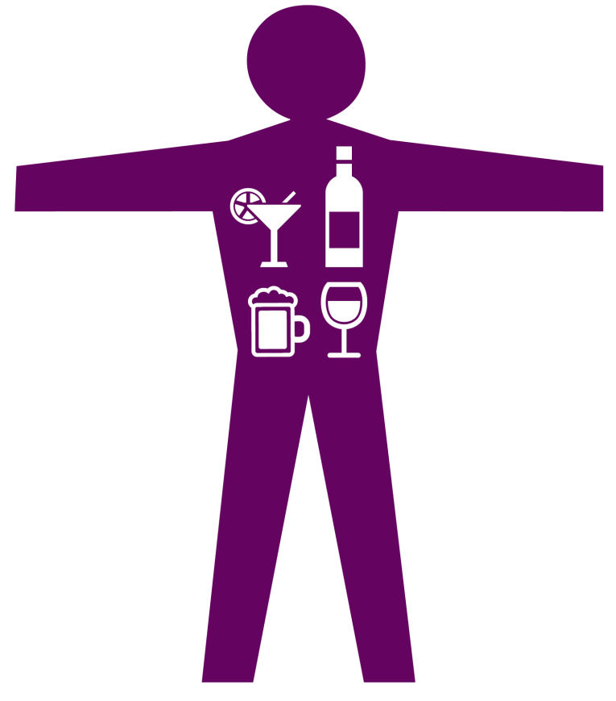
Blood alcohol concentration (BAC) is the amount of alcohol that is present in the blood stream.
At certain BAC levels, alcohol has been shown to alter a person’s visual functions and perceptions.
Notes:
Blood alcohol concentration (BAC) is the amount of alcohol that is present in the bloodstream. For example, having a BAC of 0.10 percent means there is about one drop of alcohol for every 1,000 drops of blood present in the body. At certain BAC levels, alcohol has been shown to alter a person’s visual functions and perceptions, affecting his or her ability to react, concentrate or pay attention, process information and operate a vehicle.

Slide 16
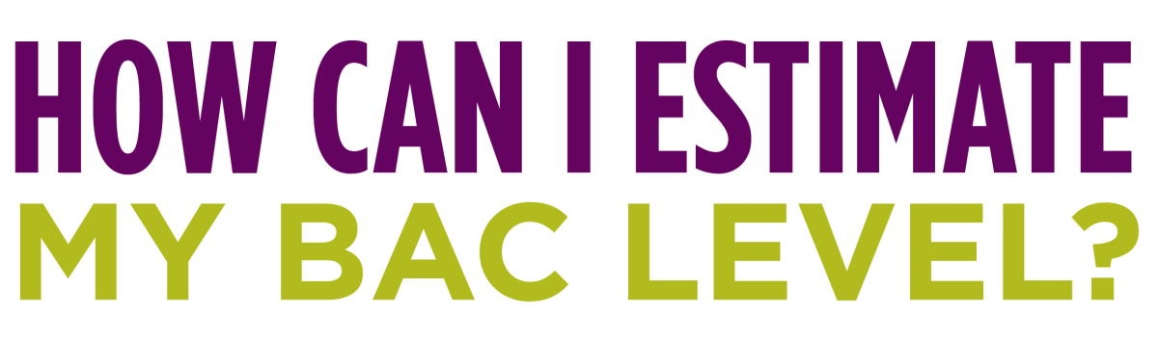
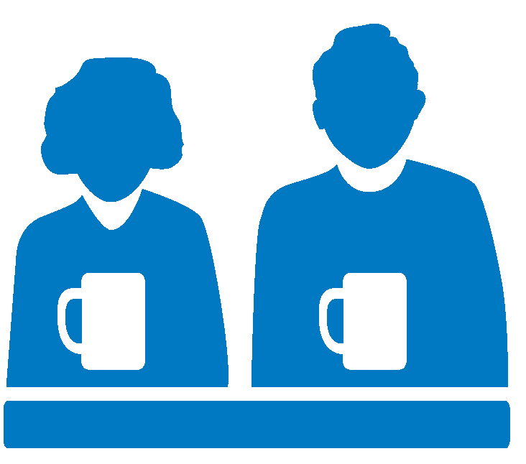
BAC can be estimated based on the number of standard size drinks, weight and gender.
If a man weighing 140 pounds has three standard-size drinks, his BAC will equal approximately .08 percent.
If a woman weighing 140 pounds has three standard-size drinks, her BAC will equal approximately .10 percent.
Notes:
You can estimate what your BAC would be after a certain number of standard size drinks by weight and gender.
Use the BAC Chart in Alcohol Education Basics Guide or the following two slides for your reference. Ask students to follow along and use the BAC Chart on pages 8-9 of the College Publication or the 21 and Older Publication.
A male and a female both, who weigh 140 pounds consume three standard-size drinks. The male’s BAC will equal approximately 0.08 percent and the female’s BAC will equal approximately 0.10 percent.
Discuss: How do the different factors that impact a person’s response to alcohol come into play in this scenario?

Slide 17
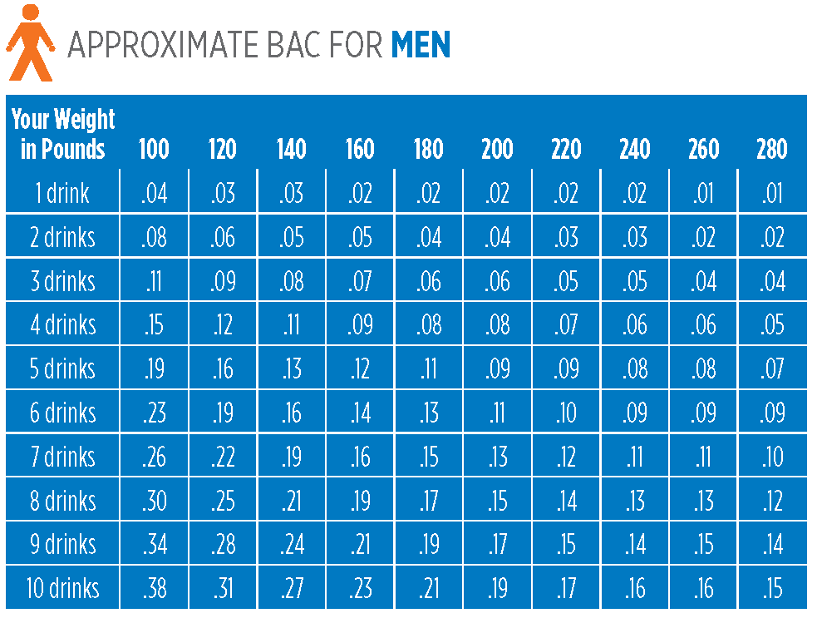
Notes:
Use this BAC Chart and the BAC Chart on the next slide to facilitate additional dialogue.

Slide 18
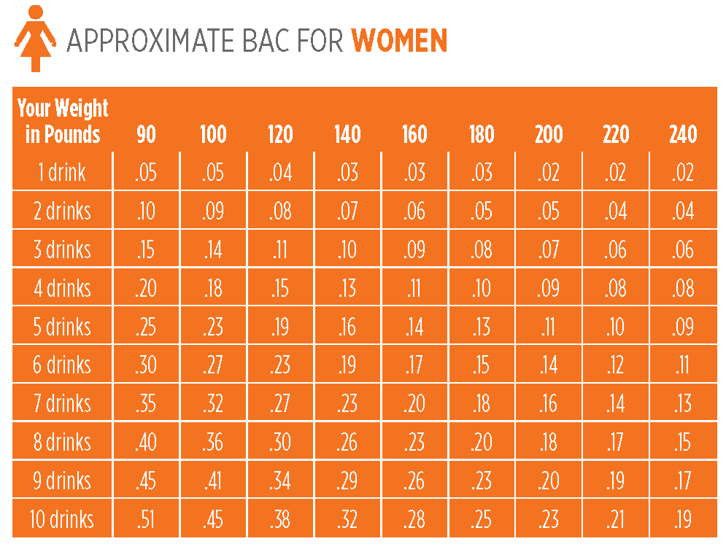
Notes:
Use this BAC Chart to facilitate additional dialogue.

Slide 19
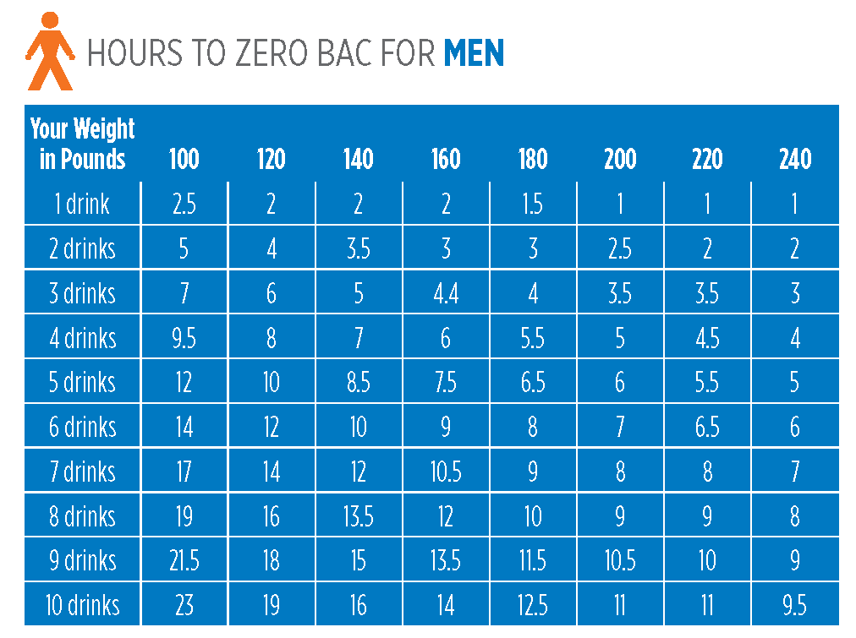
Notes:
Hours to Zero BAC for Men
Use this Hours to Zero BAC Chart and the Hours to Zero BAC Chart on the next slide to facilitate additional dialogue.
It takes the liver approximately one hour to process one standard drink. Sobering up quickly with a cold shower, exercise, eating a large meal or drinking coffee is a myth as time is the only way to eliminate alcohol from your system. You can estimate approximately how long it will take to eliminate alcohol from the body based on the number of standard size drinks you’ve consumed in addition to your gender and weight.

Slide 20
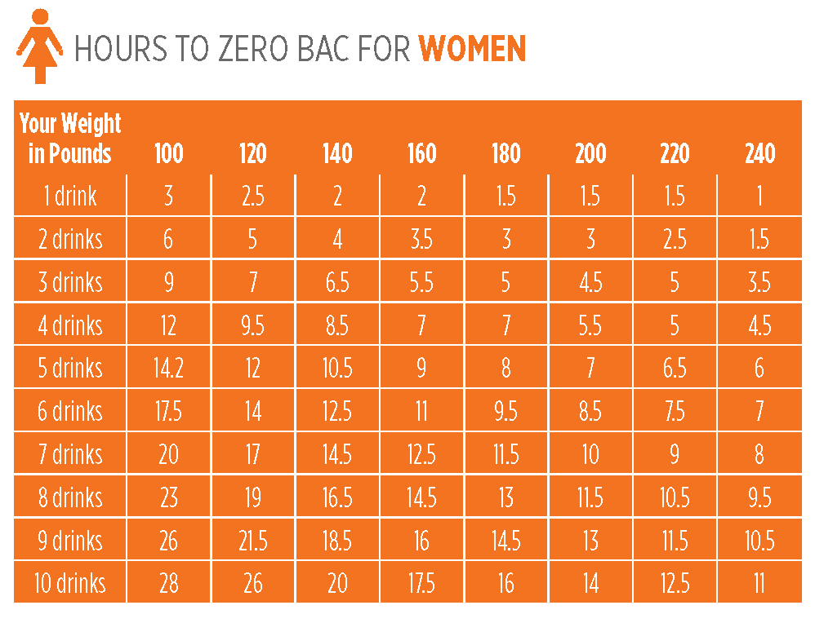
Notes:
Hours to Zero BAC For Women
Use this Hours to Zero BAC Chart to facilitate additional dialogue.
It takes the liver approximately one hour to process one standard drink. Sobering up quickly with a cold shower, exercise, eating a large meal or drinking coffee is a myth as time is the only way to eliminate alcohol from your system. You can estimate approximately how long it will take to eliminate alcohol from the body based on the number of standard size drinks you’ve consumed in addition to your gender and weight.

Slide 21
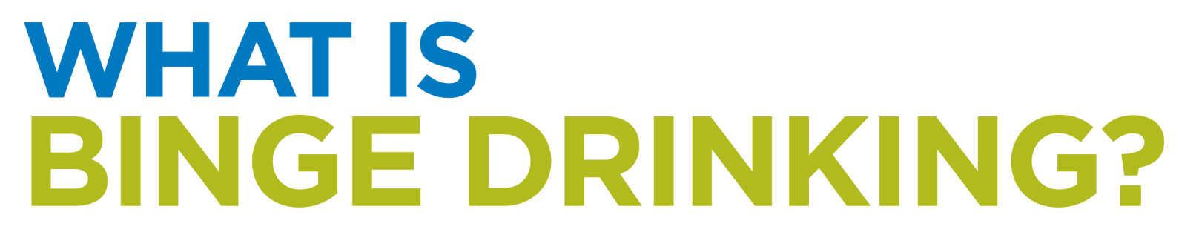
Binge drinking is the heavy consumption of alcohol that brings BAC levels to at least 0.08% in about two hours.
Women: Four Drinks
Men: Five Drinks
Notes:
Binge drinking is the heavy consumption of alcohol that brings BAC levels to at least 0.08% in about two hours. It is also defined as when a woman consumes four or more drinks or when a man consumes five or more drinks in a short period of time. When a large amount of alcohol is consumed in a short period of time, it can result in a dangerously high BAC, leading to alcohol poisoning and other negative outcomes.
Participating in drinking games can easily result in binge drinking without someone realizing it. The rapid consumption of alcohol during drinking games or while chugging drinks and taking shots can rapidly increase a person’s BAC. It can become difficult to keep track of how many standard drinks are being consumed, putting them at a higher risk of alcohol poisoning and other health-related risks.

Slide 22

45.5%
of students in a national survey responded that they avoid drinking games sometimes, most of the time or all the time.
73.1%
of students in a national survey reported drinking four or fewer drinks the last time they consumed alcohol.
Notes:
Survey Says: According to the American College Health Association’s National College Health Assessment (NCHA) Results, Spring 2016.
45.5% of students in a national survey responded that they avoid drinking games sometimes, most of the time or all the time.
73.1% of students in a national survey reported drinking four or fewer drinks the last time they consumed alcohol.

Slide 23
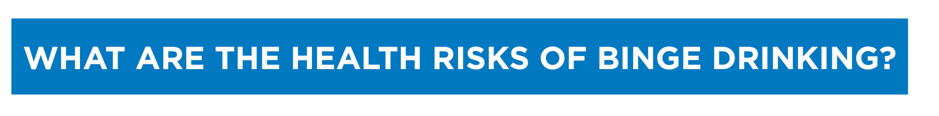
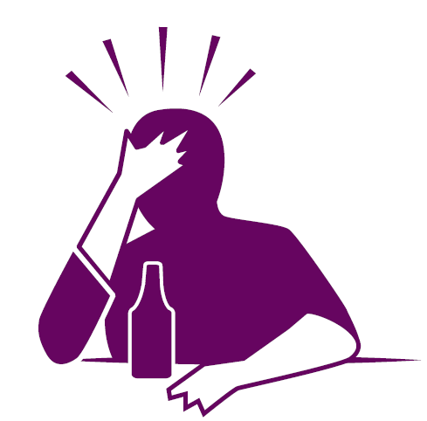
Alcohol Poisoning
Experiencing a Blackout
Brain Damage
Physical Injury
Increased Risk of Sexual Assault
Notes:
Binge drinking can lead to the following health consequences:
Experiencing a Blackout
Alcohol Poisoning
Brain Damage
Physical Injury
Increased Risk of Sexual Assault

Slide 24
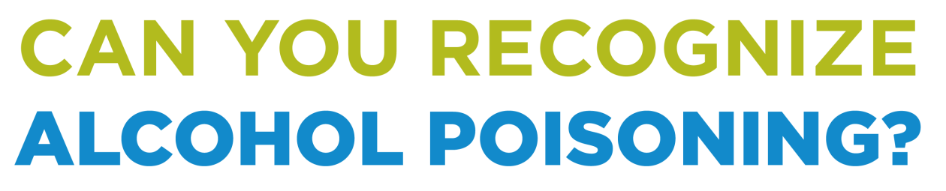
Symptoms:
  Confusion
  Slow or no reflexes or response
  Difficulty or inability to remain conscious
  Vomiting
  Trouble breathing
  Clammy, pale, or bluish lips
  Seizures
Notes:
Binge drinking and participating in drinking games can increase the likelihood of a drinker to have alcohol poisoning. Alcohol poisoning occurs when an excessive amount of alcohol is consumed, resulting in a high BAC. A large volume of alcohol in the bloodstream causes the body and its major functioning organs like the brain to consequently shut down.
Symptoms of alcohol poisoning include:
Confusion
Slow or no reflexes or response
Difficulty or inability to remain conscious
Vomiting
Trouble breathing
Clammy, pale, or bluish lips
Seizures

Slide 25
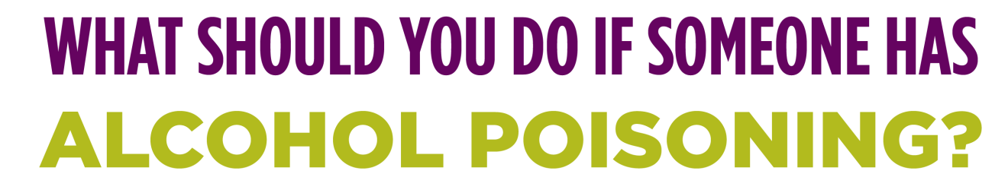
Roll them on their side
Call 911
Do not leave them alone
Do not give them food or fluids
Begin CPR if heart rate stops
Notes:
What should you do if someone has alcohol poisoning? Never assume that the person is sleeping it off and try to keep them awake.
Roll them on their side
Call 911
Do not leave them alone
Do not give them food or fluids
Begin CPR if heart rate stops

Slide 26
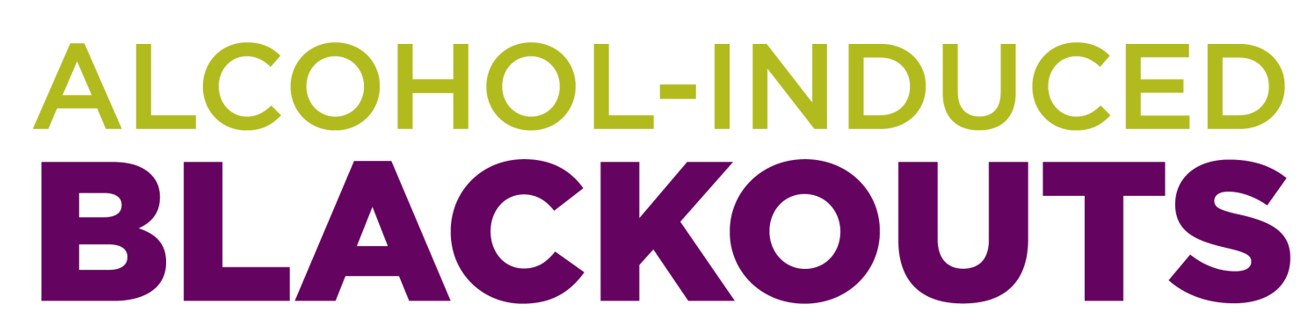
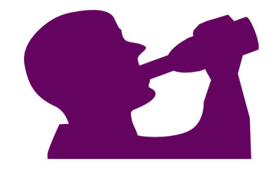
A blackout is a period of time in which an intoxicated person who has consumed a large amount of alcohol cannot recall key details of an event or the event in its entirety.
Notes:
A blackout is a period of time in which an intoxicated person who has consumed a large amount of alcohol cannot recall key details of an event or the event in its entirety. Just one blackout can lead to permanent brain damage and other negative consequences. During a blackout, an individual is conscious and awake, but later on may only have partial or no memories from any activities they participated in during that time. Blackouts can be especially dangerous due to an increased risk for engaging in risky and dangerous behaviors.

Slide 27
24.7%
of students in a national survey reported doing something they later regretted in the last
12 months when drinking alcohol.
21%
of students in a national survey reported forgetting where they were or what they did in the last
12 months when drinking alcohol.
Notes:
Survey Says: According to the American College Health Association’s National College Health Assessment (NCHA) Results, Spring 2016.
24.7% of students in a national survey reported doing something they later regretted in the last 12 months when drinking alcohol.
21% of students in a national survey reported forgetting where they were or what they did in the last 12 months when drinking alcohol.

Slide 28
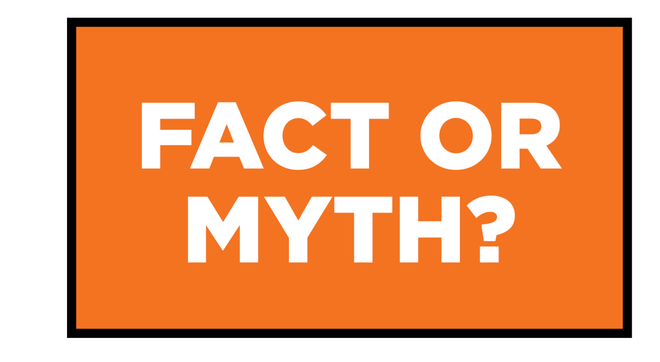
The more I drink, the better I’ll feel.
Notes:
Fact or Myth?
The more I drink, the better I’ll feel.
Myth. A drinker experiences the stimulant effects at a BAC of .06 percent or below. Once BAC surpasses .06 percent, the depressant effects of alcohol such as sluggishness, fatigue, sloppiness, lack of balance, coordination and slurred speech occur. Keeping BAC below .06 percent can reduce negative consequences associated with drinking alcohol.

Slide 29
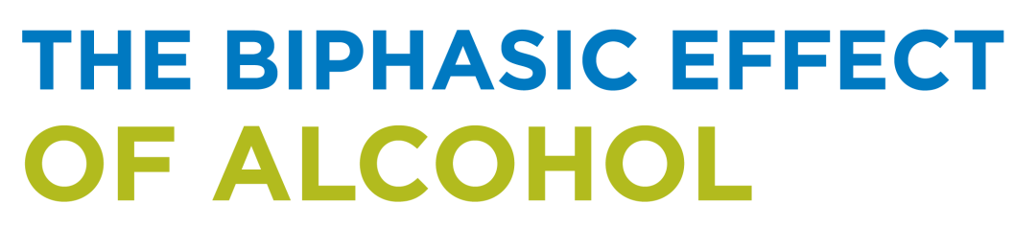
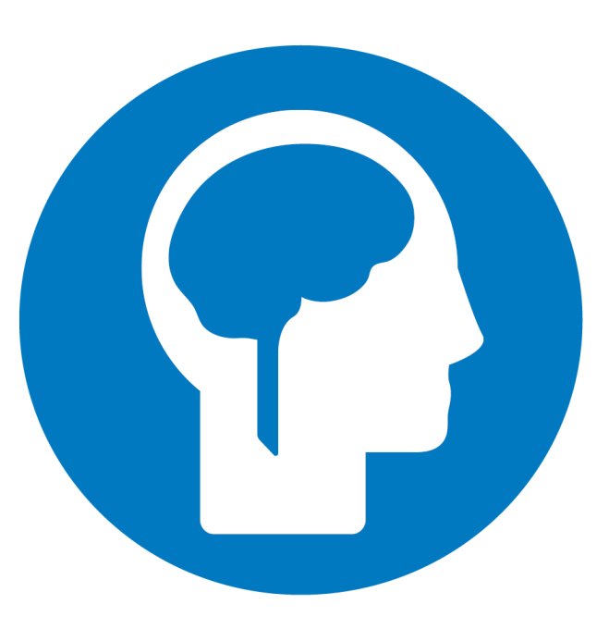
Although alcohol is a depressant, it can have euphoric effects when consumed in moderation. The stimulant effects of alcohol begin before or during the first drink, but diminish as BAC continues to increase.
Notes:
Although alcohol is a depressant, it can have euphoric effects when consumed in moderation. The stimulant effects of alcohol begin before or during the first drink, but diminish as BAC continues to increase.
During the first drink, alcohol begins to work as a stimulant, causing the brain to release dopamine which is a “feel good” excitatory neurotransmitter. Alcohol depresses the inhibitory processes in the brain resulting in a feeling of euphoria. This occurs when BAC is lower than 0.06 percent.
As drinking continues and the BAC rises, the depressant effects of alcohol kick in as the brain begins to release the gamma-aminobutyric acid (GABA) neurotransmitter that inhibits brain activity. At this stage, responsiveness, coordination and judgement are severely impaired and the individual is at a higher risk for experiencing negative outcomes. This typically occurs when BAC is higher than 0.06 percent.

Slide 30
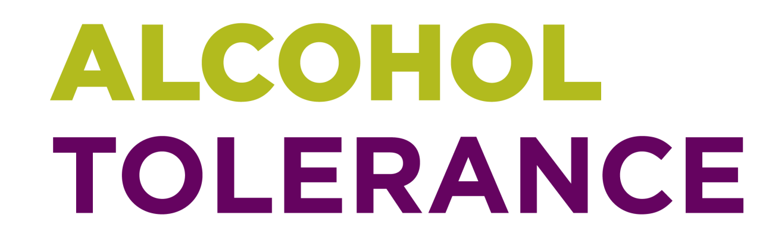
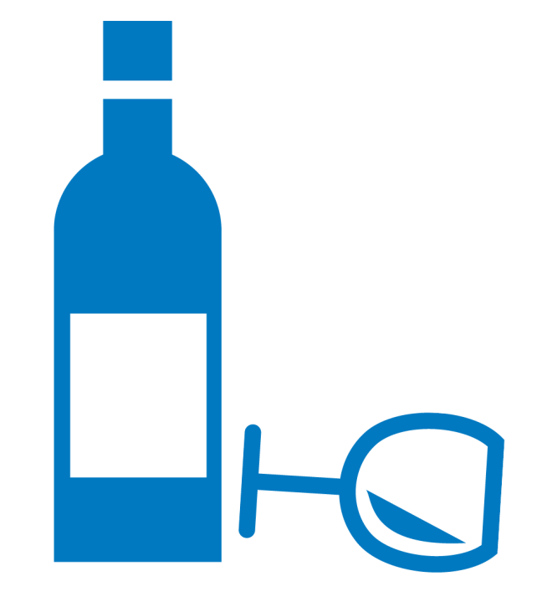
Types of Alcohol Tolerance:
  Genetic
  Environmental
  Metabolic
  Functional
Notes:
Alcohol tolerance is defined as the reduction in the stimulant effects of alcohol after a period of prolonged or heavy use. An individual drinker with a high alcohol tolerance will need to consume progressively more alcohol to experience the same effects.
Types of Alcohol Tolerance:
Genetic Tolerance: Genetics can affect a person’s response to alcohol, placing them at a higher risk of alcoholism.
Environmental Tolerance: Tolerance to alcohol can increase if alcohol is consumed in the same setting or with the same cues. This can be dangerous if the same amount of alcohol consumed in the usual environmental setting is consumed in a new setting, producing different effects.
Metabolic Tolerance: After a prolonged period of heavy use, the liver will begin to increase the number of enzymes it activates to metabolize alcohol. This reduces the time that alcohol is active in the body and the duration of its effects.
Functional Tolerance: Tolerance can develop when the brain attempts to adapt to compensate for the disruption caused by alcohol in both behavior and bodily functions.
Drinking in moderation can minimize your risk for experiencing these effects.

Slide 31
63.2%
of students in a national survey reported keeping track of how much they drank the last time they consumed alcohol.
71.6%
of students in a national survey reported eating before and/or during drinking the last time they consumed alcohol.
Notes:
Survey Says: According to the American College Health Association’s National College Health Assessment (NCHA) Results, Spring 2016.
63.2% of students in a national survey reported keeping track of how much they drank the last time they consumed alcohol.
71.6% of students in a national survey reported eating before and/or during drinking the last time they consumed alcohol.

Slide 32
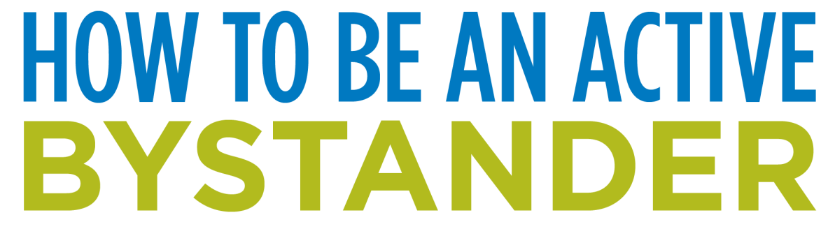
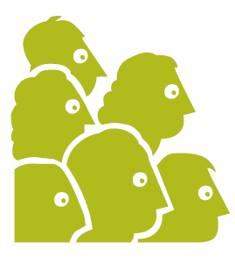
An active bystander is a person who witnesses a conflict or incident and takes action to stop the situation or help the person in trouble.
Notice the event.
Determine whether the event is a problem or an emergency and how you can safely respond.
Assume responsibility.
Come up with a plan.
Take action to protect yourself and others.
Notes:
A bystander is a person who witnesses a conflict or incident but does nothing to stop the situation or help the person in trouble. An active and empowered bystander takes action when they witness a person in need. Rather than stepping aside and doing nothing, an active bystander intervenes with the goal of helping the other person.
Before a risky situation occurs, there are clues that something may be getting out of hand. Intervening before imminent harm can reduce the likelihood of violence. Warning signs can include excessive drinking, verbal arguments and body language signaling that someone is uncomfortable.
Five Steps to Being an Active Bystander:
Notice the event.
Determine whether the event is a problem or an emergency and how you can safely respond.
Assume responsibility.
Come up with a plan.
Take action to protect yourself and others.

Slide 33
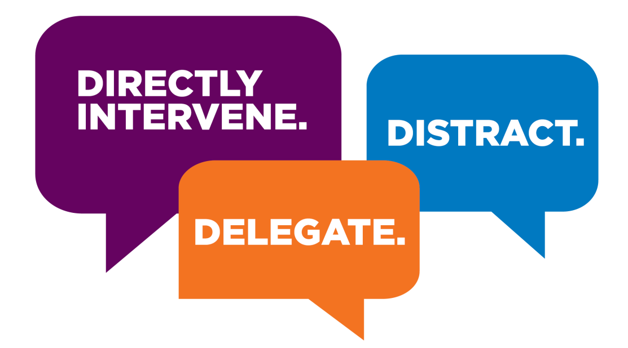
Notes:
Directly intervene in the moment to prevent a problem from occurring.
 Asking someone who looks uncomfortable in a situation, “Are you doing okay?”
 Asking a peer who is alone and highly intoxicated if they have a plan for getting home.
 Noticing a friend has had three shots of liquor in the past hour and asking them if they think it might be a good idea to slow down so they won’t feel sick later in the evening.
Delegate: Seek assistance from someone else, whether a peer or police officer.
 If you feel uncomfortable acting alone, don’t hesitate to ask a friend or a peer to help you out.
 If you think the situation may be too risky for you to intervene, try seeking out a campus faculty or staff member. If you are out at a bar, ask a bartender, bouncer or police officer.
Distract: Interrupt the situation without directly confronting the harmful behavior.
 If it appears that someone is taking advantage of a person who has clearly had too much to drink at a party, distract the offender by interrupting the situation. Even if you don’t know the person, interject by saying “Hey, I was looking for you!” Be creative!

Slide 34
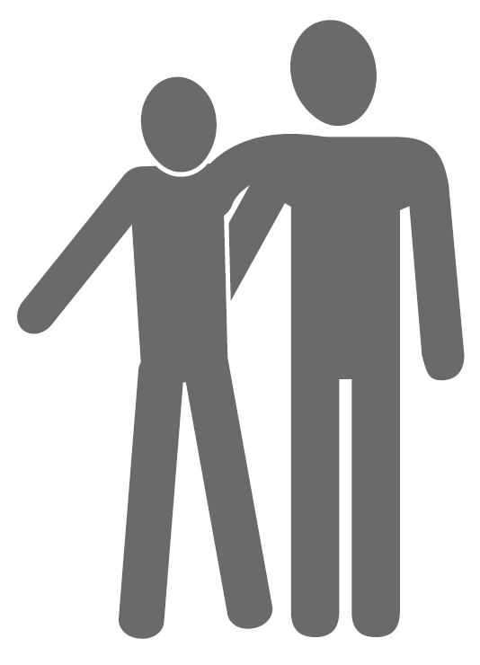
44.6%
of students in a national survey reported having a friend to let them know when they’ve had enough.
Notes:
Survey Says: According to the American College Health Association’s National College Health Assessment (NCHA) Results, Spring 2016.
44.6% of students in a national survey reported having a friend to let them know when they’ve had enough.

Slide 35
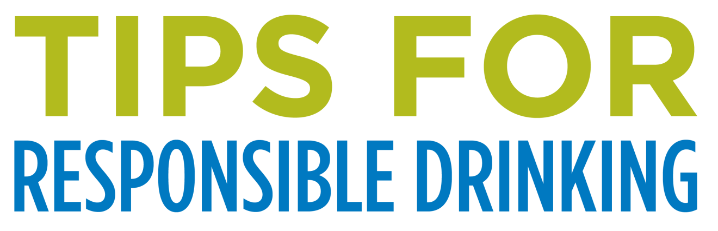
Know the law and only drink if you’re of legal age.
Know what a standard drink size is so you can accurately track how much you are drinking.
Pace yourself and don’t consume more than one standard drink every hour.
Alternate between a non-alcoholic beverage, water and food.
Don’t drink on an empty stomach. Eat foods high in protein before, during and after you drink.
Notes:
How can you make responsible decisions?
Know the law and only drink if you’re of legal age.
Know what a standard drink size is so you can accurately track how much you are drinking.
Pace yourself and don’t consume more than one standard drink every hour.
Alternate between a non-alcoholic beverage, water and food.
Don’t drink on an empty stomach. Eat foods high in protein before, during and after you drink.

Slide 36
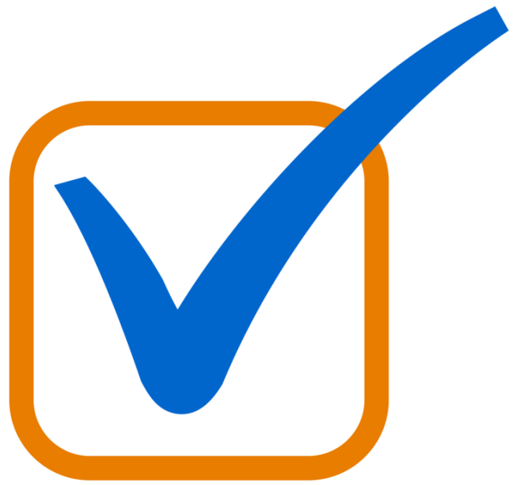
Stick to the plan you made in advance and get home safely.
Remember that only time will lower your BAC.
Understand that alcohol affects men and women differently.
Never give your friends a hard time if they choose not to drink.
Never drink and drive.
Notes:
How can you make responsible decisions?
Since judgment is the first brain function to be affected by alcohol, it is important to consider making a plan before you go out to party, including how you will get there and back, who you will go with, and some strategies for turning down a drink.
Stick to the plan you made in advance and get home safely.
Remember that only time will lower BAC.
Understand that alcohol affects men and women differently.
Never give your friends a hard time if they choose not to drink.
Never drink and drive.

Slide 37
QUESTIONS?
For more information, visit our
website at www. thenybusiness. com

